Slide 1
Agenda: Wednesday September 7, 2016
Warm Up
20 minutes for proposal discussions
Vocab. 1 (7, 8)
TIB
Homework: Go to thisibelieve.org and explore the organization’s purpose and many examples of published essays.
This should give you a better idea of your task and some ideas for your own writing.
Random fact of the day:

Slide 2
Warm Up: 9/7
Choose one of the following questions to write about and discuss:
What causes people to stick to their beliefs, or to change their beliefs? When have you witnessed this in your life or in history?
What are common beliefs that people live by? Is it good to have strong beliefs? Why? Try to list some real-life examples.
Think of a book/movie/TV show where a character has used their beliefs to guide their decision making. Describe the character and the situations he/she encountered where this belief became significant.

Slide 3
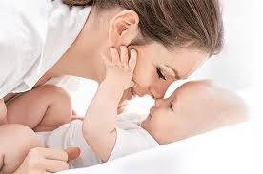
Vocabulary 1: Humans
Root: GYNE <G. “woman”
7. Gynecology – n- The branch of medicine dealing with disorders and treatment of the reproductive system in women.
Gynecology is a promising field for medical students, who are especially interested in women’s health.
8. Misogyny – n- dislike of or ingrained prejudice against women
The woman strongly believed it was her boss’s misogyny that kept her from receiving a promotion.

Slide 4
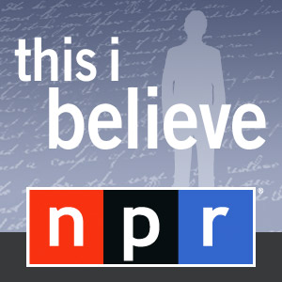
Introduction to This I Believe Essay
Radio talk-show that began in the 50s - post WWII
Americans - both well-known and unknown - read five minute beliefs about their philosophies about life
Over 60 years later, students and citizens from all over the country are still writing these 500 words essays for NPR

Slide 5
Writing: Agree/ Disagree
Life is fair.
Words can hurt.
Police are your friends.
What goes around comes around.
How you act in a crisis shows who you really are.
An eye for an eye makes the whole world blind.
People learn from their mistakes.
You can’t depend on anyone else; you can only depend on yourself.
If you smile long enough, you become happy.
Miracles do happen.
There is one special person for everyone.
Money can not buy happiness.
Killing is wrong.
Doing what’s right means obeying the law.
Individuals who dress provocatively are asking for trouble.

Slide 6
Follow Up Writing
What is a belief? Which of the beliefs just discussed holds true for you, and why?
What’s the difference between a belief and a value?
What is one of your strongest beliefs? When/how was it formed? When/how was it tested? When/why has it changed?
Why is it important to study the beliefs of others, even those with whom you disagree?

Slide 7
Examples
Failure is a good thing - as we listen to the first example, pay attention to what you notice the writer doing stylistically.
I Am Still The Greatest
Do What You Love
A Doubtful, Questioning Mind
Be Cool to the Pizza Dude
Former Student Examples:
I Believe In Rainbows

Slide 8
Personal Essay Writing
What is it? A personal essay is focused on belief or insight about life that is significant to the writer, supported by life experience and/or relationships that have taught the writer what individual values are most important.
What are some of the qualities of personal essay writing? (Rubric)
Style/Technique | Organization - Narrative Coherence | Reflective - shows communal significance
Should reveal true experiences: intellectual or emotional Use personal anecdotes to express beliefs Vivid description: Use of sensory language When appropriate, effective use of dialogue | Focuses on a key belief or concept Controlled and appropriate pacing Subtle Transitions Paragraphing - often shorter, though not always | “So what?” Does the essay communicate a larger truth? Often personal essay has two sections: narrative and reflection.

Slide 9
Brainstorming
You may use options 1, 2, and/or 3.
Write in your notebooks.

Slide 10
Writing: Sample Belief Statements
“I believe in being cool to the pizza delivery dude.”
“I believe we are not alone.”
“I believe that remembering is the best way to move forward.”
“I believe in my mother’s advice.”
“I believe that we shape our world with kindness and love of what we do in the simplest moments every day.”
“I believe in always parking in the last parking spot.”
I believe that if you are constantly reliving your past, you will never move forward.”

Slide 11
Writing: Your beliefs
1) In your writer’s notebook, write a paragraph about why you agree/disagree with one of the statements. Try to use personal experience to support your response. This is to practice supporting and explaining a personal belief.
2) You need to come up with 5 of your own personal belief statements that you can work with.
I believe that...
I used to believe that...

Slide 12
Warm Up- 9/7
The Greeks advanced math, writing, and the arts. Greeks created theatre, democracy, politics, Olympic sports, philosophy, and underwear!
1. How do you think your life would be different if the Greeks hadn’t invented (choose one from above) _______________.
The Greeks believed in a way of life based on “the good, the true, and the beautiful”
1. What might happen to you if all of Colorado suddenly dedicated themselves to living “the good, the true and the beautiful” way of life?

Slide 13
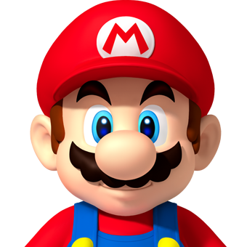
Biography
Myth
Mario is the protagonist in several console games. He has to defeat several villains (King Koopa being the main antagonist) in order to save Princess Peach
Phenomenon
Significant Interactions
“Watch out for that banana peel!”
Mario is able to eat mushrooms to grow, leaves to turn into a flying raccoon, and flowers to spit fireball pellets.

Slide 14
Agenda: Friday September 9, 2016
Warm Up
Vocab. 1 (9, 10)
TIB essay

Slide 15
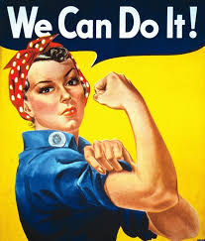
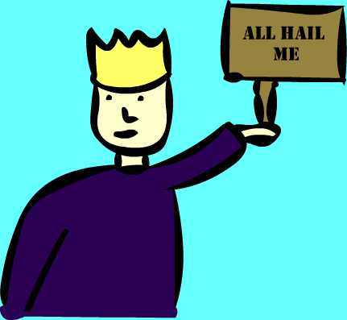
Vocabulary 1: Humans
Root: FEMINA <L. “woman”
9. Feminism – n- The belief that women should possess the same political and economic rights as men.
The union president’s feminism led him to demand equal pay for women who perform the same jobs as men.
Root: AUTOS <G. “self”
10. Autocrat –n- 1. A ruler who has absolute power; 2. Any arrogant, dominating person.
^{1.} Elizabeth II cannot become an autocrat like her ancestor Elizabeth I because today the monarch’s power is limited by Parliament.
^{2.} As company director she became an autocrat, making all decisions with taking advice.

