Slide 1
Agenda: Tuesday September 27, 2016
Warm Up
Vocabulary 2 (1, 2)
Writing- Reflection of 1st 6 weeks
-Use at least 3 compound sentences and 2 complex sentences.
Reading – The Odyssey background info/ The Hero’s Journey
College Fair this week!
Conferences on Oct. 13
Grades posted!
Random fact of the day:
The word "lethologica" describes the state of not being able to remember the word you want.

Slide 2
Warm Up- 9/27
What is the difference between effort and compliance?
When/why is it okay to procrastinate? Is it ever okay?
What qualifies as “A” material/work?

Slide 3
Vocabulary 2: Race, Family
GENOS, GENEOS <G. “race” “family”
1. genealogy – n- A record of descent from one’s ancestors; the study of family records.
Toni Morrison’s novel, Song of Solomon traces the genealogy of an American family from the mid-twentieth century back o their African heritage.
2. genocide – n- The planned annihilation of a racial, political, or cultural group.
The Nazi effort to eliminate all Jews is the most extensive attempt of genocide in history.

Slide 4
Writing: Reflection → THIS GETS ITS OWN PAGE! 15 minutes
In your notebooks, take some time to reflect over the last 6 weeks of school.
Is your grade where you want it to be?
What could you have done differently? Is what you’re doing working?
Do your expectations for yourself match your teacher’s expectations for you?
Are these expectations clear?
What can you change; do you want to change?
How can you progress and move forward?
Are you producing quality work, or are you just “getting by”?
Consider what we discussed in our warm up.
Give this some thoughtful consideration.
Be sure to include at least 3 compound sentences and 2 complex sentences.

Slide 5
The Odyssey Background/ The Hero’s Journey
Intro to The Odyssey
The Hero’s Journey
You will need to take notes!

Slide 6
Agenda: Thursday September 29, 2016
Warm Up
Vocabulary 2 (3, 4)
Reading –The Hero’s Journey/ The Odyssey
HW: Find the “Hero Quest PowerPoint” and take notes.
Random fact of the day:

Slide 7
Warm Up- 9/29

Slide 8
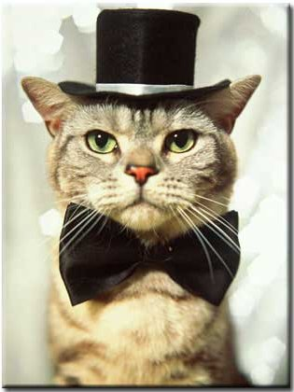
Vocabulary 2: Race, Family
GENS, GENTIS <L. “race” “clan” “family”
3. genre- n- A type, class, or category, especially of fine art or history.
Edna Ferber’s writing encompasses several genres – fiction, drama, and autobiography.
4. genteel – adj- Well-mannered; refined; polite; false polite
Although they tried to look genteel, their vulgar language and rude behavior betrayed their lack of refinement.

Slide 9
The Odyssey Background/ The Hero’s Journey
Intro to The Odyssey
The Hero’s Journey
You will need to take notes!
The Odyssey: Active Reading
Please fill out as we read.
Questions? Write in discussion box!

