Slide 1
Agenda: Tuesday September 13, 2016
Warm up
Vocab
TIB
Poll- TKaM
Random fact of the day:

Slide 2
Warm Up
Choose one and rewrite it using better description.
It was the first day of ninth grade, and I felt really nervous as I walked to my first class.
Climbing up the mountain, I really felt a strong connection to nature.
When my dad told me I couldn’t go to the tournament because of my grades, I was really angry.

Slide 3
Vocabulary 1: Humans
Root: AUTOS <G. “self”
11. Automaton –n- A person who behaves in a mechanical, routine manner; a robot.
Her job on the assembly line caused her to feel like an automaton.
12. Autonomy – n- The condition of being self-governing; independence.
Kenyans fought for autonomy from British rule, and Kenya became a republic in 1964.

Slide 4
Examples
Failure is a good thing - as we listen to the first example, pay attention to what you notice the writer doing stylistically.
I Am Still The Greatest
Do What You Love
A Doubtful, Questioning Mind
Be Cool to the Pizza Dude
Former Student Examples:
I Believe In Rainbows

Slide 5
Personal Essay Writing
What is it? A personal essay is focused on belief or insight about life that is significant to the writer, supported by life experience and/or relationships that have taught the writer what individual values are most important.
What are some of the qualities of personal essay writing? (Rubric)
Style/Technique | Organization - Narrative Coherence | Reflective - shows communal significance
Should reveal true experiences: intellectual or emotional Use personal anecdotes to express beliefs Vivid description: Use of sensory language When appropriate, effective use of dialogue | Focuses on a key belief or concept Controlled and appropriate pacing Subtle Transitions Paragraphing - often shorter, though not always | “So what?” Does the essay communicate a larger truth? Often personal essay has two sections: narrative and reflection.

Slide 6
Writing: Sample Belief Statements
“I believe in being cool to the pizza delivery dude.”
“I believe we are not alone.”
“I believe that remembering is the best way to move forward.”
“I believe in my mother’s advice.”
“I believe that we shape our world with kindness and love of what we do in the simplest moments every day.”
“I believe in always parking in the last parking spot.”
I believe that if you are constantly reliving your past, you will never move forward.”

Slide 7
Writing: Your beliefs
1) In your writer’s notebook, write a paragraph about why you agree/disagree with one of the statements. Try to use personal experience to support your response. This is to practice supporting and explaining a personal belief.
2) You need to come up with 5 of your own personal belief statements that you can work with.
I believe that...
I used to believe that...

Slide 8
Brainstorming
You may use options 1, 2, and/or 3.
Write in your notebooks.

Slide 9
Structuring the TIB
Chronological Order
Intro - Belief Statement
Order of significant
moments
chronologically
III. Reflection - connect everything back to belief statement
Order of Importance
Intro - Belief Statement
Order of moments by level of importance
III. Reflection - connect everything back to belief statement

Slide 10
Structuring the TIB
Look at your brainstorming.
Do you have primarily anecdotes to explain your belief?
Do you have more observational ideas to explain your belief?
Does your belief center around a certain series of events that took place for you?

Slide 11
Review- Organization of Structure: Pizza Dude
Can you identify each of the following? Highlight.
- The belief statement (yellow)
- Anecdotes (personal experiences, relationships, or acts of witness) that illuminate this belief (green)
- Reflection - places where the writer is making connections between their stories and their belief and emphasizing its importance (pink)
- Conclusion - includes added reflection and makes connection back to the belief statement (orange)
Identify areas where the flow could be improved.
Identify any areas in the writing that seem disconnected from the topic.

Slide 12
Agenda: Thursday September 15, 2016
Warm up
Vocab → Test Wednesday
TIB → Due Wednesday 9/21
Library orientation/ Mythology Project
End of 1st 6 weeks next Friday!
HW:
1. Bring HARD copy of your fully completed rough draft to class on Monday.
2. TIB- FINAL due on Wednesday 9/21: Submit to Turnitin.com AND bring a hard copy to physically turn in.
Random fact of the day:
When in a group situation, approximately 88% of individuals will conform to the behavior of the group.
Social Conformity

Slide 13
Warm Up- 9/15
Describe this moment with vivid detail:
Walking into your 9th grade Honors English class and meeting your teacher for the first time.

Slide 14
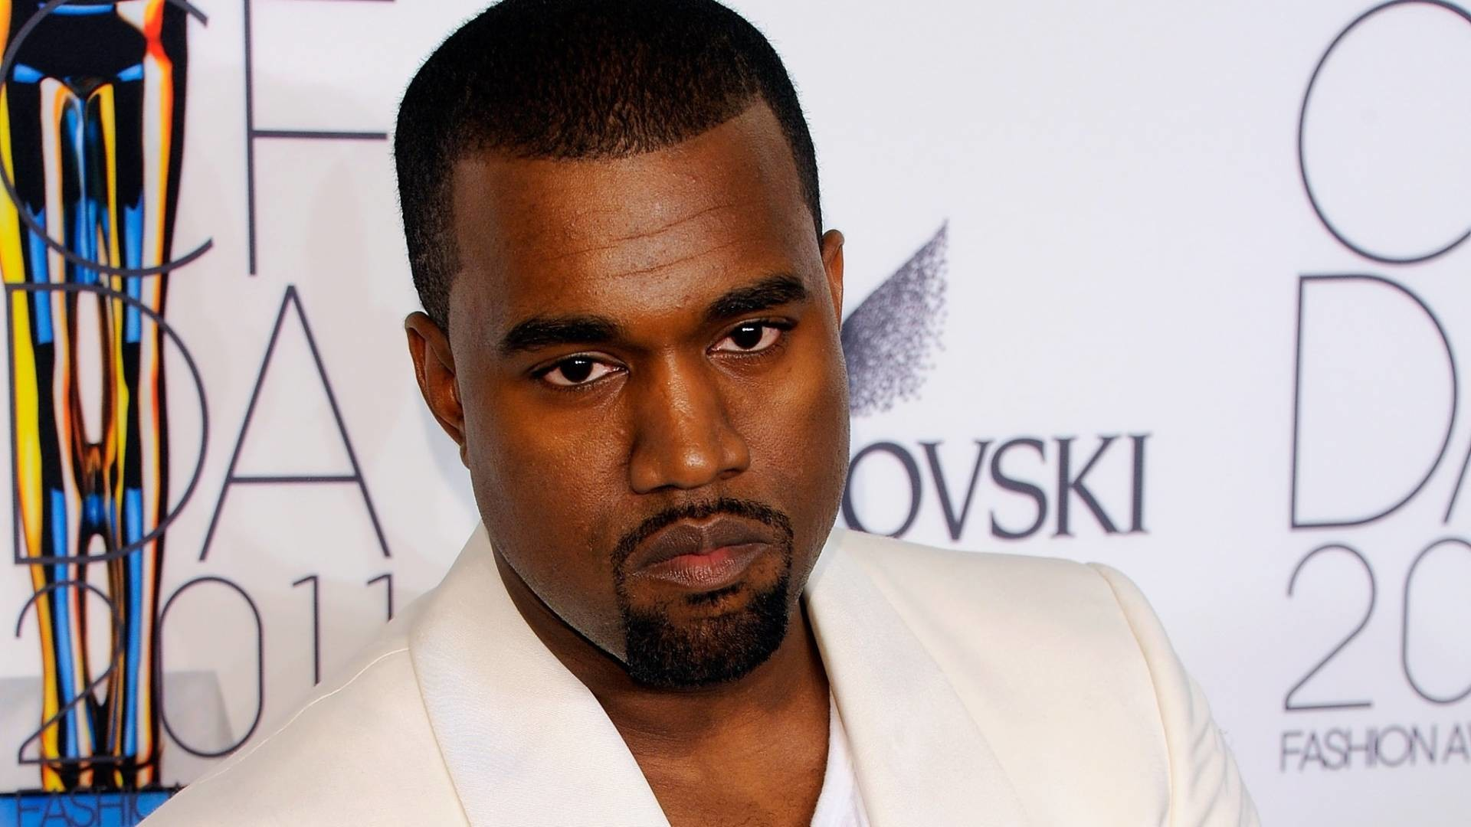
Vocabulary 1: Humans – TEST WEDNESDAY!
Root: AUTOS <G. “self”
13. Autopsy – n- Examination of a corpse to determine the cause of death
An autopsy of the mummy revealed that the Pharaoh had died of lead poisoning.
Root: EGO <L. “I”
14. Egoism –n- Conceit; valuing everything according to one’s personal interest. Excessive confidence in one’s own opinion.
Cleopatra’s egoism may have resulted from her power, ability, and charm.

Slide 15
Descriptors
- Help the reader envision what it is you are describing, especially if it a place/person/object or moment of great importance
- Be imaginative and interesting, but don’t go overboard. Be concise! Find a couple creative ways to describe something and move on with your writing.
Be interesting - but not boring

Slide 16
Adding good descriptors
1. Compare what you’re describing to something different or unexpected.
Example:
The wind was very fast.
The wind was faster than a train.
That morning, it smelled nice.
I breathed in the smell of early morning, the smell of the first drop of dew on grass.
From Jackie Robinson’s essay:
Ok wording:
Backwards ideas may exist, but they can’t keep humanity from advancing.
Way cooler wording:
There is no Middle Ages logic so strong that it can stop the human tide from flowing forward.

Slide 17
Adding good descriptors continued
2. Think of the concrete details that the reader wouldn’t be able to imagine.
Zoom in on the moment. What are the subtle details that will bring this person/place right off the page?
Example:
In Grandpa’s bedroom, time stood still. The clock was still broken, the faded picture of the grandmother I never met still faced the patchwork bed, his favorite books still crowded the shelves. The only thing changed was the tree outside the window, the leaves turning the orange of a dying fire.
3. What could be symbolic in this paragraph? Give special attention to it.

Slide 18
Still adding good descriptors
4. Avoid wimpy verbs!
He walks into the room.
Walks = wimpy and boring
He slumps into the room.
He strides into the room.
He slides into the room.

Slide 19
Add Dialogue
Why use it?
It can reveal more about a character, and more subtly, than simply telling the reading what to think. It gives voice to people from your stories...and you, as well.
I remember two things from the funeral circuit: bottomless dishes of free mints and my father saying on the ride home, “You can’t come in without going out, kids. Always go to the funeral.”
See “Tomorrow will be a better day”

Slide 20
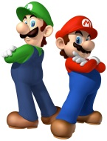
Greek Mythology Project: Due 9/23
Myth
Biography
Mario is best friends with Bowser. They met when Mario saved him from a terrible spin out while they were racing. It has been said that Princess Peach threw shells at Bowser to prevent him from kidnapping her. Mario, being the good chap that he is, helped Bowser out by giving him a star to protect him from future attacks from Peach.
Mario is the protagonist in several console games. He has to defeat several villains (King Koopa being the main antagonist) in order to save Princess Peach. Occasionally his brother, Luigi helps him.
Phenomenon
Significant Interactions
Mario is able to eat mushrooms to grow, leaves to turn into a flying raccoon, and flowers to spit fireball pellets.
“Watch out for that banana peel!”
Mario has made several appearances in other video games; The Legend of Zelda, Donkey Kong.

