Slide 1
Brianna
Miles
Autumn
Brock
Topher
Gabe
Alex
Gisselle
Mylissa
Wambdi
Fabian
Raina
Skylar
Matthew
Alondra
Steven
Destiny
Tristen
Jonessa
Dre’
Osiel
Janee’
Dominic
Sage
Jake
Dawan
Front of classroom
Door

Slide 2
Agenda: Tuesday September 6, 2016
Warm up
Vocabulary 1 (3, 4)
Grammar- adjectives
Reading- All in the Family/ Details
Writing- Revise PEA #1
Random fact of the day:
“Facebook Addiction Disorder” is now considered a psychological disorder.

Slide 3
Warm Up 9/6
Whenever he was so fortunate as to have near him a hare that had been kept too long, or a meat pie made with rancid butter, he gorged himself with such violence that this veins swelled, and the moisture broke out on his forehead. – Thomas Babington Macaulay, “Samuel Johnson”
What effect does the detail (spoiled hare, rancid butter, swollen veins, sweaty forehead) have on the reader?
How would the sentence change by ending it after himself?
You try:
Write a sentence describing someone with disgusting eating habits. It must be one, correct sentence; and it must contain at least three vivid details.

Slide 4
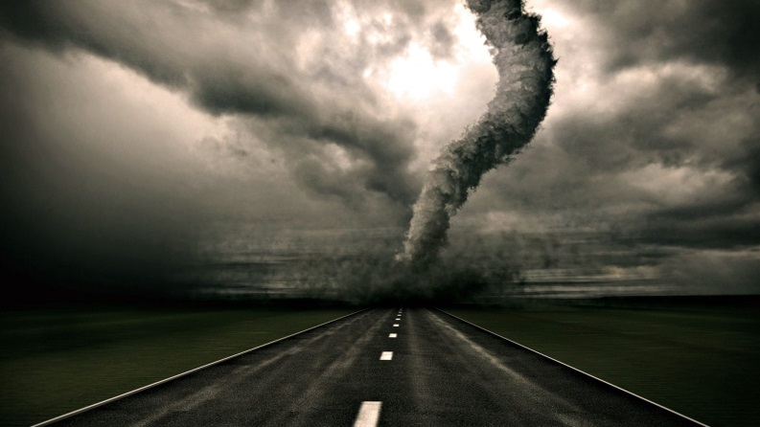
Vocabulary 1: Bringing and Building
3. deportee (n)- someone who is sent out of the country
The deportee was not happy about returning to his native country.
4. destructive (adj)- causing something to be destroyed or demolished.
The fire was very destructive, causing a million dollars’ worth of damage.

Slide 5
P.U.G.S. - Adjectives
Identify the adjectives in the following sentences.
An enjoyable way to travel to a new country is on a spotted horse.
Kendall needs some help.
The shiny spaceship landed in my small yard.
Moving to a new school could be a terrifying experience.
Mrs. Phelps’ students will not have homework tonight!

Slide 6
P.U.G.S. & Writing- Descriptive paragraphs
Find your “vacation location” warm up from 8/30
Write a descriptive paragraph:
My ideal vacation location consists of a warm, sandy beach with crystal clear water. As I would walk along the beach, the sand would easily glide between my toes and feel as soft as a pillow. A few sun-kissed locals would be playing volleyball, smelling of coconuts and sun tan lotion. As the champagne waves crashed into the shore, I would see flashes of the brilliant colors and stripes on each sea shell. The air would smell salty with a few breezes of sweet. As I would dig my toes into the sand, I would feel a sense of relaxation-as if this was a moment stuck in time.
If your warm up is already in the form of a paragraph, revise it and add 3 more adjectives. Be as descriptive as possible including examples. Make sure you have at least 1 simile.

Slide 7
Reading: Details, Character, Plot
3 sides of the room:
Go stand next to the technique that you like the best when reading or watching a film.
Details
Character
Plot

Slide 8
Reading: Categorical Chart
Turn to your Reading section in your Binder. Use an entire page to create the chart below. Leave space to write details in each blank box.

Slide 9
Reading: Details: All in the Family, pg. 856
Fill in categorical chart with details in regards to setting, character, & plot.
Predict what will happen to the narrator based on the ending.
How does the family’s attitude toward the mirror change?
Describe Clara’s character.
Does the character of Clara make the store more or less believable?
Describe be the narrator’s tone.

Slide 10
Agenda: Thursday September 8, 2016
Warm up
Vocab. 1 (5, 6)
Grammar- adjectives and subjects
Reading- Choosing your text & reading Short story #1
Writing- Revise PEA #1 – Lakewood Tigers
Random fact of the day:
There is enough DNA in the human body to go from the Sun to Pluto and back 17 times.

Slide 11
Warm Up 9/8
¹An old man, Don Tomasito, the baker, played the tuba. ²When he blew into the huge mouthpiece, his face would turn purple and his thousand wrinkles would disappear as his skin filled out. – Alberto Alvara Rios, “The Iguana Killer”
The first sentences is a general statement. How does the second sentence enrich and intensify the first?
Contrast the second sentence with the following:
When he blew his tuba, his face turned purple and his cheeks puffed out.
Which sentence more effectively expresses an attitude toward Tomasito? What is that attitude and how is it communicated?
You do:
Describes someone jumping over a puddle. Your first sentence should be general, stating the action simply. Your second sentence should clarify and intensify the action through detail.
Example: Jane jumped over the puddle. As she jumped, she held her breath and her pigtails flew up smacking the sides of her head.

Slide 12
Vocabulary 1: Bringing and Building
5. export (v) – to send goods out of the country to another country for the purpose of selling
The company’s business doubled once it started exporting its products to other countries.
6. import (v)- to bring goods from a foreign country into a country for the purpose of selling
There are many products we import because we cannot grow them in our country.

Slide 13
P.U.G.S. Adjectives and subjects
Subject – who or what the sentence is about.
Ex. Mrs. Phelps is a die hard Ohio State fan.
Underline the subjects and circle the adjectives:
1. The boys won the Cross Country meet.
2. Sharks and dinosaurs would not make great pets.
3. Volleyball is my most favorite sport.

Slide 14
Reading: Categorical Chart
Turn to your Reading section in your Binder. Use an entire page to create the chart below. Leave space to write details in each blank box.
Clara – independent, bold, boastful, mischievous
Narrator -

Slide 15
Reading: Details: All in the Family, pg. 856
Fill in categorical chart with details in regards to setting, character, & plot.
Predict what will happen to the narrator based on the ending.
How does the family’s attitude toward the mirror change?
Describe Clara’s character.
Does the character of Clara make the store more or less believable?
Describe be the narrator’s tone.

Slide 16
Reading: Details: All in the Family, pg. 856
Fill in categorical chart with details in regards to setting, character, & plot.
Predict what will happen to the narrator based on the ending.
How does the family’s attitude toward the mirror change?
Describe Clara’s character.
Does the character of Clara make the store more or less believable?
Describe be the narrator’s tone.

Slide 17
Reading: Choose the right Texts for you
Carousel notes-
Walk around the room and write down the notes necessary to choosing
Step 1: Get to know yourself as a reader.
- Question yourself
Step 2: Apply knowledge learned from step 1.
-Your interests
Step 3: Consider HOW you choose texts and consider HOW you actually read.
-Willing vs. challenge?
-Slow or fast reader?
-Need quiet or can work in chaos?

Slide 18
STEP 1: GET TO KNOW YOURSELF AS A READER.
What genres, books, authors, or reading have you enjoyed in the past? Why?
What do you read regularly (magazines, blogs, websites, apps, manuals, books)?
What, specifically, are you interested in (activities, sports, music, science, fantasy, etc.)?
For what purpose do you read (learning, obligation, enjoyment)?
Is reading difficult or easy for you? Do you read fast or slow? Do you want to be interested in what you read?
Are you willing to or do you want to challenge yourself?

Slide 19
STEP 2: APPLY THE KNOWLEDGE YOU LEARNED FROM STEP 1.
Part A: Start with WHAT: think about your answers from Step 1.
If you enjoyed a John Green (The Fault in Our Stars) book you read, then you might enjoy another of his books.
If you like the television series Pretty Little Liars, then you might like the books.
If you like Stranger Things, then you may enjoy R.L. Stine or Steven King.
If you love science and technology, then you might like Wired (magazine or website).
If you enjoy reading Facebook posts, Instagram posts, or Twitter posts- your focus should be on 1st person narratives: Gone Girl by Gillian Flynn, The Martian by Andy Weir, If I Stay by Gale Foreman
Part B: Then consider WHY: maybe you have a mismatch of purpose.
Remember in English class, your texts will be a mixture of both forms: entertain and inform
Part C: Be clear and realistic about WHO you are as a reader.
If you want a challenge, then choose the 300 page book. If you don’t want a challenge, choose the 150 page book.
Reading is like any sport or skill: you have to practice over and over again and mess up and build strength and stamina. In which case, maybe you do choose the longer book rather than the shorter one.

Slide 20
STEP 3: Consider HOW you choose texts you read and consider HOW you actually read.
If you know you’re a slow reader who needs quiet, set aside time to read and make sure you have a quiet space to do so.
Get recommendations from friends, family, classmates, teachers, or other sources that you trust.
Peruse the text. Look over the cover, read the title and synopsis, read a random paragraph or page, talk to others about it, etc.
When was the last time you tried something new? You should read at least 1-2 paragraphs and/or two chapters before you give up.
Suspend your judgment. Don’t just give up at the first tough vocabulary word. See if you can figure out another strategy to help you move forward.

Slide 21
Reading: Short Stories
The Sniper (pg. 162) The Necklace (pg. 26) The Scarlet Ibis (pg. 592)
Skim over the pictures, vocabulary words, and text.
Which story do you think you will be interested in reading?
Begin reading story #1.

