Slide 1
Brianna
Miles
Autumn
Brock
Topher
Gabe
Alex
Gisselle
Mylissa
Wambdi
Fabian
Raina
Skylar
Matthew
Alondra
Steven
Destiny
Tristen
Jonessa
Dre’
Osiel
Janee’
Dominic
Sage
Jake
Dawan
Front of classroom
Door

Slide 2
Agenda: Tuesday September 6, 2016
Warm up
Vocabulary 1 (3, 4)
Grammar- adjectives
Reading- All in the Family/ Details
Writing- Revise PEA #1
Random fact of the day:
“Facebook Addiction Disorder” is now considered a psychological disorder.

Slide 3
Warm Up 9/6
Whenever he was so fortunate as to have near him a hare that had been kept too long, or a meat pie made with rancid butter, he gorged himself with such violence that this veins swelled, and the moisture broke out on his forehead. – Thomas Babington Macaulay, “Samuel Johnson”
What effect does the detail (spoiled hare, rancid butter, swollen veins, sweaty forehead) have on the reader?
How would the sentence change by ending it after himself?
You try:
Write a sentence describing someone with disgusting eating habits. It must be one, correct sentence; and it must contain at least three vivid details.

Slide 4
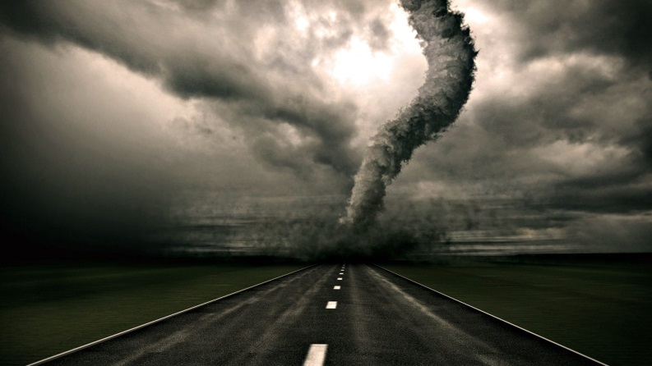
Vocabulary 1: Bringing and Building
3. deportee (n)- someone who is sent out of the country
The deportee was not happy about returning to his native country.
4. destructive (adj)- causing something to be destroyed or demolished.
The fire was very destructive, causing a million dollars’ worth of damage.

Slide 5
P.U.G.S. - Adjectives
Identify the adjectives in the following sentences.
An enjoyable way to travel to a new country is on a spotted horse.
Kendall needs some help.
The shiny spaceship landed in my small yard.
Moving to a new school could be a terrifying experience.
Mrs. Phelps’ students will not have homework tonight!

Slide 6
P.U.G.S. & Writing- Descriptive paragraphs
Find your “vacation location” warm up from 8/30
Write a descriptive paragraph:
My ideal vacation location consists of a warm, sandy beach with crystal clear water. As I would walk along the beach, the sand would easily glide between my toes and feel as soft as a pillow. A few sun-kissed locals would be playing volleyball, smelling of coconuts and sun tan lotion. As the champagne waves crashed into the shore, I would see flashes of the brilliant colors and stripes on each sea shell. The air would smell salty with a few breezes of sweet. As I would dig my toes into the sand, I would feel a sense of relaxation-as if this was a moment stuck in time.
If your warm up is already in the form of a paragraph, revise it and add 3 more adjectives. Be as descriptive as possible including examples. Make sure you have at least 1 simile.

Slide 7
Reading: Details, Character, Plot
3 sides of the room:
Go stand next to the technique that you like the best when reading or watching a film.
Details
Character
Plot

Slide 8
Reading: Categorical Chart
Turn to your Reading section in your Binder. Use an entire page to create the chart below. Leave space to write details in each blank box.

Slide 9
Reading: Details: All in the Family, pg. 856
Fill in categorical chart with details in regards to setting, character, & plot.
Predict what will happen to the narrator based on the ending.
How does the family’s attitude toward the mirror change?
Describe Clara’s character.
Does the character of Clara make the store more or less believable?
Describe be the narrator’s tone.

Slide 10
Agenda: Thursday September 8, 2016
Warm up
Vocab. 1 (5, 6)
Grammar- adjectives and subjects
Reading- Choosing your text
Writing- Revise PEA #1 – Lakewood Tigers
Random fact of the day:

Slide 11
Vocabulary 1: Bringing and Building
5. export (v) – to send goods out of the country to another country for the purpose of selling
The company’s business doubled once it started exporting its products to other countries.
6. import (v)- to bring goods from a foreign country into a country for the purpose of selling
There are many products we import because we cannot grow them in our country.

Slide 12
P.U.G.S. Adjectives and subjects
Subject – who or what the sentence is about.
Ex. Mrs. Phelps is a die hard Ohio State fan.
Underline the subjects and circle the adjectives:
1. The boys won the Cross Country meet.
2. Sharks and dinosaurs would not make great pets.
3. Volleyball is my most favorite sport.

Slide 13
Reading: Choose the right Texts for you
Carousel notes-
Walk around the room and write down the notes necessary to choosing
Step 1: Get to know yourself as a reader.
Step 2: Apply knowledge learned from step 1.
-Your interests
Step 3: Consider HOW you choose texts you read and consider HOW you actually read.
-Willing vs. challenge?
-Slow or fast reader?
-Need quiet or can work in chaos?

Slide 14
Reading: Short Stories
Skim over the pictures, vocabulary words, and text.
Which story do you think you will be interested in reading?
Begin reading.

