Slide 1
Agenda: Tuesday September 20, 2016
Warm up
Short Story Assessment
Writing- Article of the Week
Reading- The Odyssey background information
Mini- Project assignment
All missing work due by Thursday.
Random fact of the day:
Porcupines float in water.

Slide 2
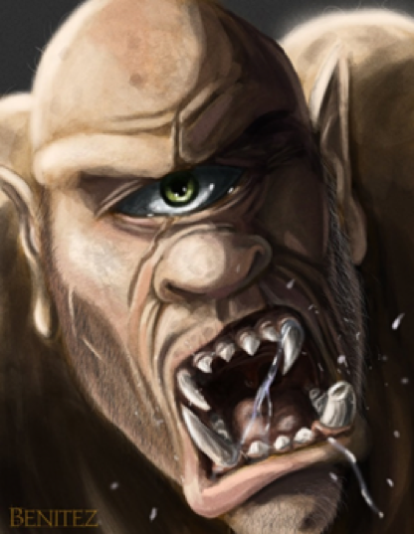
Warm Up 9/20
What do you know about Ancient Greek culture and society? ← You already answered this in your notes.
What do you know about the Trojan War?

Slide 3
Short Story Assessment
Use may use your chart – only your chart
Answer in complete sentences.

Slide 4
Article of the Week
Why and how do we annotate?
Annotate the article

Slide 6
The Odyssey: Unit Objectives
Understand The Hero's Journey and apply the stages to The Odyssey and other texts.
Analyze what cultural values and human qualities are represented through each stage of Odysseus's journey.

Slide 7
Values of The Greeks
Belief/Faith
Everything the Greeks did was to please/not anger the gods
Mythical creatures also play a huge role
Intelligence
This was the number one weapon/tool of the time
Glory: equivalent to FAME
War stories
Souls that achieved glory during life were given privileges in Hades
Hospitality
Helping others
Offered food, shelter, protection to travelers without question
Hospitable even when they didn’t want to be
Brotherly duty or fear of the gods?
Loyalty
family, community, & gods
Bravery

Slide 8
The History
You’re going to see a few clips from the movie Troy, and hear a little bit of background info
Take notes! A one sentence summary from each one is fine!

Slide 9
The History
Paris steals Helen 1:26
https://www.youtube.com/watch?v=X2He7pHCjH4
Paris vs. Menalaus 4:16
https://www.youtube.com/watch?v=eS9kqq6PNnQ
Odysseus asks Achilles for help: 3:54
https://www.youtube.com/watch?v=CWLb2F0MEoY
Hector vs. Achilles 4:31
https://www.youtube.com/watch?v=80SsC_ZNbyI
Trojan Horse 2:45
https://www.youtube.com/watch?v=Td1uPq9K--E

Slide 10
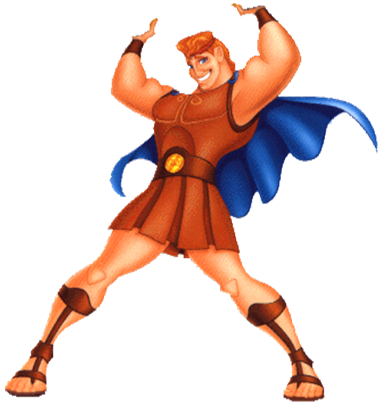
Heroes
•Definition:
the protagonist of an epic poem
Brave and noble character
Admired for great achievements
Affected by great events
Example: Odysseus, Hercules

Slide 11
Heroes Continued
Epic Hero Characteristics:
Super-human qualities (stronger/braver than others)
Still human, so has a flaw/weakness
Must conquer many difficult tasks
On a quest for something of great value (to him or his people)
Villain(s) try to keep the hero from his quest
Knows that the Gods come first, then heroes, then humans
Physically beautiful

Slide 12
The Hero’s Journey
There will be TWO journeys in The Odyssey
Get ready for fast notes!
Number 1-12
You’re going to need to watch this video for CONTENT, not for entertainment.
Yeah, there’s cute stuff but if you get stuck on the cuteness, you’ll miss the content!
https://vimeo.com/140767141

