Slide 1
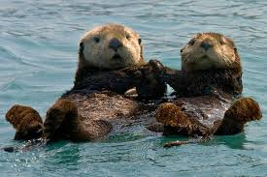
Agenda: Thursday September 8, 2016
Warm up
Vocab. 1 (7, 8) → TEST FRIDAY
Grammar- adjectives review
Reading- Mini-lesson on characters: Reading Short story #1 & #2
Random fact of the day:
Sea otters hold hands when they sleep so they don’t drift away from each other.

Slide 2
Warm Up 9/12
Create a character. Describe them (paragraph or list)with as much detail as possible.
What do they look like?
Smell like?
Sound like?
What are they wearing?
How old are they?
Example:
Jim was in his late 70s. He wore faded blue jean overalls with a white undershirt; his work boots were unlaced. Often times we saw him sitting in the rocking chair on his front porch. He smelled like Swedish fish, old cigarettes, and mint. When he spoke, it was low and raspy- almost inaudible. He was one of those older men who when they spoke, everyone stopped to listen. When he smiled, it was contagious. A mouth full of white teeth, most likely dentures. Surprisingly, he still had a head full of hair; grayish white. His demeanor was welcoming and reassuring. He was everyone’s Grandpa.

Slide 3
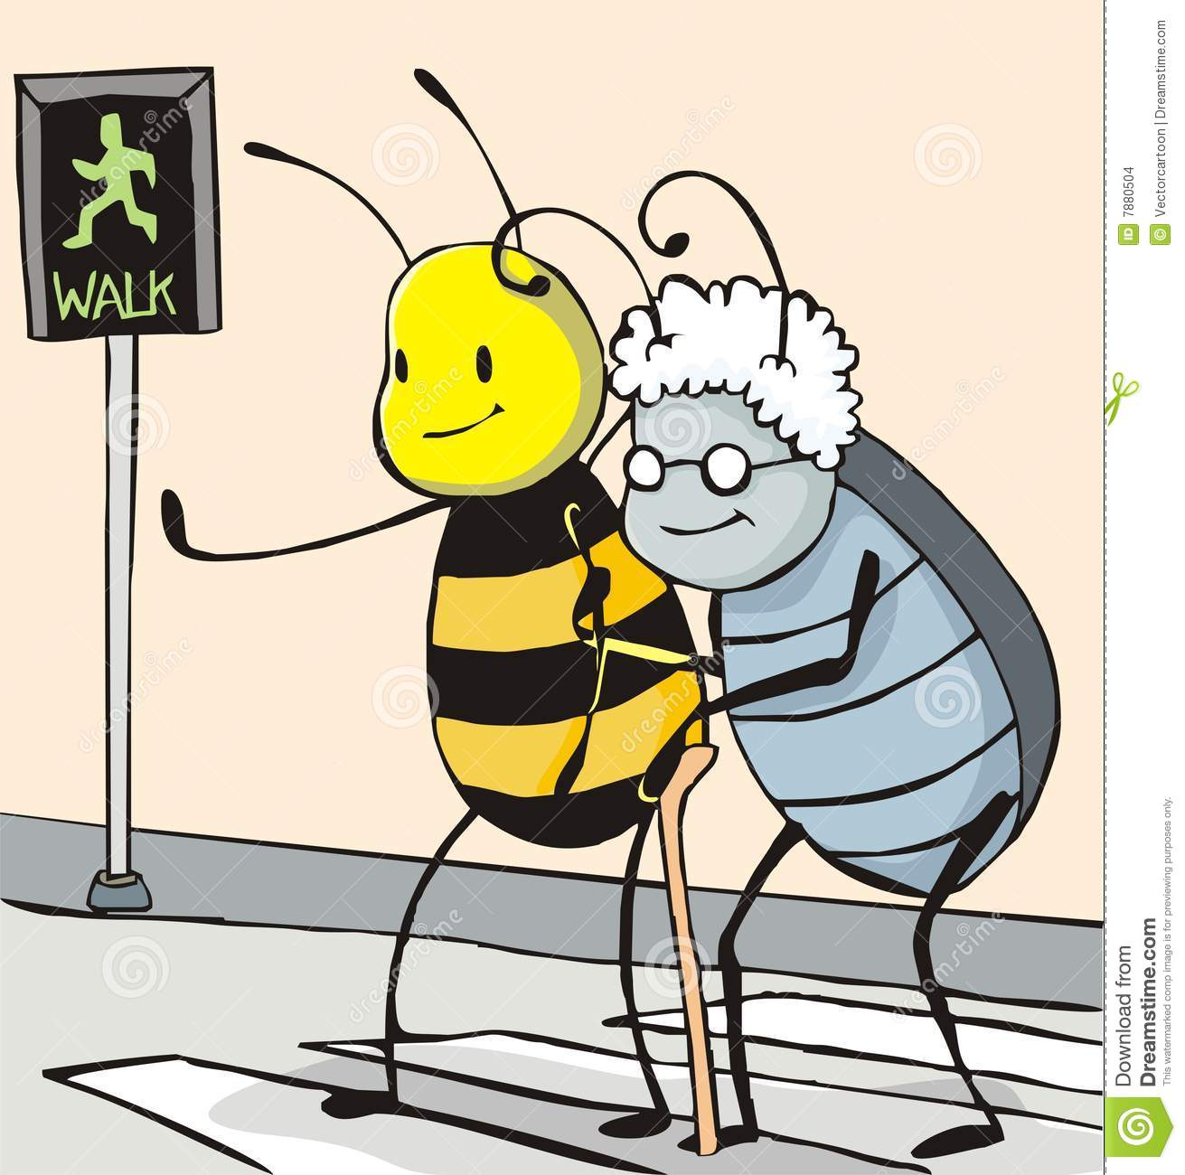
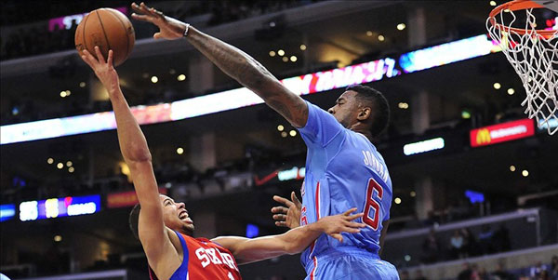
Vocabulary 1: Bringing and Building
7. instrumental (adj)- helpful; useful
She was instrumental in getting an agreement among all the companies.
8. obstruct (v) – to block or put obstacles in the way
The guard tried to obstruct the center’s attempt to make a basket.

Slide 4
Reading Mini Lesson: Characters
What makes a character? A person?
Protagonist-
Antagonist-
Round- Multi-dimensional
Flat- One- dimensional
Static- Does not change over the course of the story
Dynamic- Does change over the course of the story
Personality:
Indirect:
Direct:

Slide 5
Reading: Categorical Chart
Begin reading your first short story. Be certain to fill in the chart as you read.
Spain?
Dining room
Clara – independent, bold, boastful, mischievous
Narrator -
Discover mirror
Clara returns and discovers mirror, eats mirror lettuce, dies, tries to get narrator.

Slide 6
Reading: Character Questions
1. List 2 positive and 2 negative character traits of the main character
2. What differences do you see between the main character and the character in your warm up?
3. At what points did the character’s behavior change?
4. How would this story have been different if it was YOU as the main character instead of the actual main character?
Finished reading, filling out chart, and answering questions?
Revise your PEA paragraph- Lakewood Tiger

Slide 7
Exit Ticket

Slide 8
Agenda: Wednesday September 14, 2016
Warm up
Vocab. 1 (9, 10) → TEST FRIDAY!
Grammar- adjectives review
Reading- Mini-lesson on plot: Reading Short story #2
Writing – Revise your PEA paragraph (What it means to be a Lakewood Tiger)
Random fact of the day:

Slide 9
Warm Up 9/14
1. Put the character you created on 9/12 into your vacation location warm up from 9/8.

Slide 10
Vocabulary 1: Bringing and Building
9. potable (adj) - capable of being consumed by drinking.
The green monster shake Brittany made this morning, did not appear to be potable, but she said it was delicous.
10. structural (adj) – related to building or construction
The earthquake caused structural damage, but no people were hurt.

Slide 11
P.U.G.S. - Adjectives
Let’s review

Slide 12
Reading:Mini lesson- Plot
What makes for a good story line?
Plot chart:

Slide 13
Reading: Categorical Chart
Begin reading your first short story. Be certain to fill in the chart as you read.
Spain?
Dining room
Clara – independent, bold, boastful, mischievous
Narrator -
Discover mirror
Clara returns and discovers mirror, eats mirror lettuce, dies, tries to get narrator.

Slide 14
Reading: Plot Questions
What is the plot of the selection you made? (Your short story)
What parts of the plot can you relate to?
What is the exposition of your story? Did it effectively draw your attention and lay foundation?
What happens in your short story that you believe is rising action?
What part of your story is the climax?
Identify some events in your story that show falling action.
What point of your story was the Resolution?
Would your short story make a good movie or Netflix/Hulu series?
Finished with the chart? Turn it in!
Finish the questions (both character and plot)
Revise your PEA paragraph based on my comments and the rubric.
Finished with everything? Write a goal for yourself in regards to your MAP testing score.

