Slide 1
Agenda: Tuesday August 23, 2016
Notebook set up
Warm Up
Review summer assignment
PEA prompt #1
Annotations
Literary merit
Voc. 1,2 ?

Slide 2
Notebook set up
Sections:
Warm Ups
Vocabulary → or bring flash cards
Class notes
Writing

Slide 3
Warm Up: Class notebook
Do you think education is a right or a privilege? Support your answer.
Education

Slide 4
Summer Assignment: BWHTW
With 2-3 people around you, share your ideas that you focused on in your essays.
First, allow each person 1-2 minutes to summarize their ideas.
Second, discuss your ideas as a group. What are the similarities in your responses? The differences? Do you disagree on any points? What else are you left thinking about after hearing your peers’ responses?

Slide 5
Summer Assignment: PEA Paragraph
Annotate pgs.134-135 Beginning with “By late January…” Ending with “…they demanded.”
Then, in a PEA style paragraph, analyze the purpose of the passage and the techniques the writer uses in order to achieve this purpose.
20 minutes
P: Point
E: Evidence
A: Analysis

Slide 6
Group Share
Discuss your findings with 2-3 people around you.
What do you think is the purpose of the passage?
What specific literary elements did you notice in the passage?
Be prepared to share your ideas as we review and annotate the passage as a whole class.

Slide 7
Summer Assignment: The Boy Who Harnessed the Wind
Annotations: How and why do we annotate?
With the people at your table, collectively write your how’s and why’s individually on sticky notes.
Ex.
HOW
Underline
WHY
For fun ☺

Slide 8
Choose a passage
With a group, select a passage that you believe is highly significant to the novel. Reread independently and annotate for the elements of this passage and the author techniques that you think are important.

Slide 9
Agenda: Thursday August 25, 2016
Warm Up
Voc. 1,2
Annotations
Thesis statements
Project proposal

Slide 10
Warm Up
Who or what is your motivation?
Could/Would you work towards something without the support of your family or closest friends?

Slide 11
Vocabulary 1: Humans
Root | Part of speech & definition
Sentence | Visual OR Synonyms
WORD

Slide 12
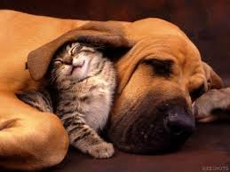
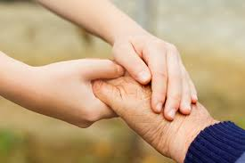
Vocabulary 1: Humans
Root: HUMANUS <L. “human being”
1. Humanities –n- Branches of knowledge concerned with human beings and their culture: philosophy, literature, and the fine arts, as distinguished from the other sciences.
Although most of her college courses were in the humanities, she did graduate work in electrical engineering.
2. Humane - adj. Having the worthy qualities of human beings, such as kindness or compassion.
The International Labor Organization helps to ensure humane conditions in the workplace.

Slide 13
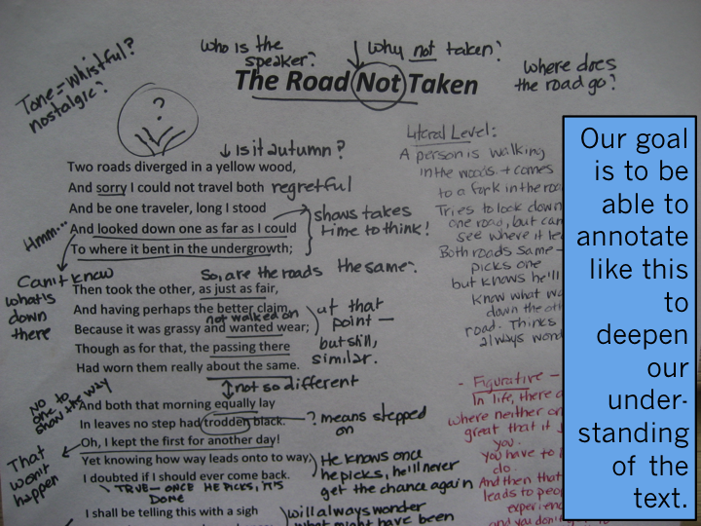
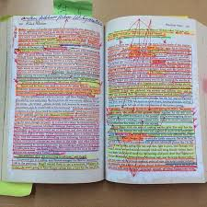
Class Annotation
Everyone annotates differently.
What to look for: literary elements, interesting information, themes/motifs (dark vs. light, happy vs. sad, etc.)
Question the text!

Slide 14
Summer Assignment: The Boy Who Harnessed the Wind
Annotations: How and why do we annotate?
With the people at your table, collectively write your how’s and why’s individually on sticky notes.
Ex.
HOW
Underline
WHY
For fun ☺

Slide 15
Choose a passage
With a group, select a passage that you believe is highly significant to the novel. Reread independently and annotate for the elements of this passage and the author techniques that you think are important.

Slide 16
Class notes: Thesis Statement
Define thesis statement in your own words.

Slide 17
Thesis Statement
a short statement, usually one sentence:
summarizes the main point or claim of an essay, research paper, etc.
Last sentence of the 1st paragraph

Slide 18
Different types of thesis statements
Open vs. Closed
An Open Thesis does not preview major points but may include opposing views
i.e. While hybrid cars are beneficial for the environment, they often cost more money due to supply and demand.
**A Closed Thesis makes the claim and previews the major points the writer will make.**
i.e. Everyone should drive a hybrid car because they pollute less, they get better mileage, and they help reduce gasoline costs.

Slide 19
Formula- for my math peeps
Just as a² + b² = c²…
Subject + opinion & 3 supports = Thesis

Slide 20
1. Read the thesis statement. 2. What is the claim? 3. How does the writer intend to prove the claim?
The three-dimensional characters, exciting plot, and complex themes of the Harry Potter series make them not only legendary children’s books but enduring literary classics.
Claim: the series constitutes a “literary “classic
Reasons:
Characters
Plot
Theme

Slide 21
Class notes: Practice: Respond with a closed thesis statement
With all the opportunities available for education, why do you think some students are still disinterested in learning?
Do you think that it is difficult to succeed in today’s world as a self-taught individual?
What does it take to overcome obstacles in today’s society?
Why do many believe in magic and divine forces? In other words, what does the belief in magic do for individuals?

