Slide 1
Tuesday March 7, 2017
Essays due today to turnitin.com
Family Tree/ Prologue
Movie

Slide 2
RJ Family Tree

Slide 3
The Prologue
Two households, both alike in dignity,
In fair Verona, where we lay our scene,
From ancient grudge break to new mutiny,
Where civil blood makes civil hands unclean.
From forth the fatal loins of these two foes
A pair of star-crossed lovers take their life;
Whose misadventur’d piteous overthrows
Doth with their death bury their parents’ strife.
The fearful passage of their death-mark’d love,
And the continuance of their parents’ rage,
Which, but their children’s end, nought could remove,
Is now the two hours’ traffic of our stage;
The which if you with patient ears attend,
What here shall miss, our toil shall strive to mend.

Slide 4
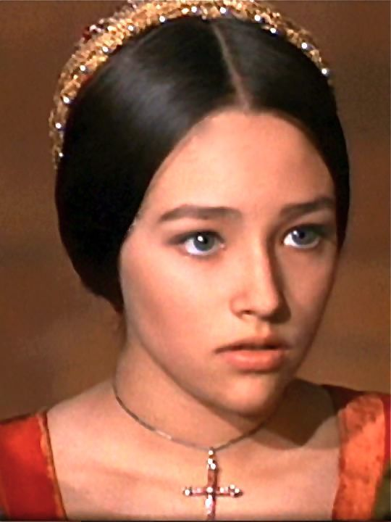
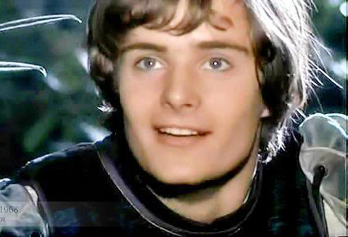
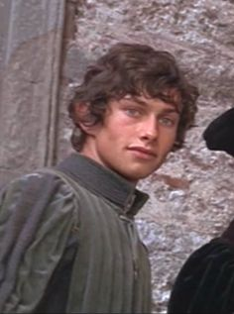
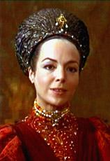
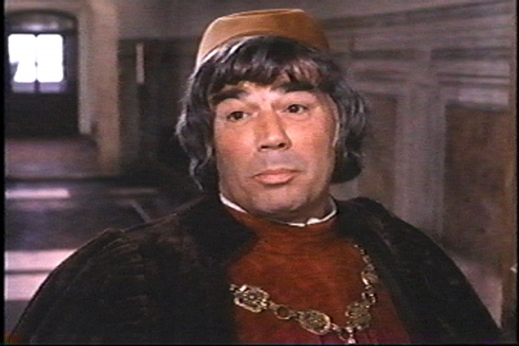
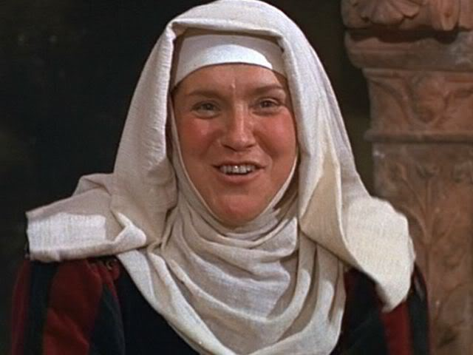
Act I, Scene I
Romeo Juliet Benvolio
Lady Capulet Capulet Paris
Nurse

Slide 5
Thursday March 9, 2017
Recap
Romeo and Juliet movie
Romeo and Juliet notes

Slide 6
Romeo and Juliet Notes
Time Covered in R&J
Act I: Saturday
Act II: Early Sunday morning through Sunday afternoon
Act III: Sunday afternoon through Monday just after dawn
Act IV: Monday through Wednesday dawn
Act V: Thursday until just before dawn Friday
Elements of a Tragedy
Main character dies
Characters are usually upper class
Main character has a flaw
The story ends with good results.

Slide 7
Romeo and Juliet Notes
Iambic Pentameter
Iambic - Soft sound followed by a hard sound.( unstressed/stressed syllables)
Ex. Ep-i-der-mis Ex. You look so good. Ex. Slide into my DMs.
Ex. I would not eat them in a box. → Read this like Count Dracula would.
I would not eat them with a fox.
Pentameter- 5 foot line of poetry. (5 meters) ( ) ( ) ( ) ( ) ( )
Ex. But soft! What light through yonder window breaks?
Ex. It is the east and Juliet’s the sun.
Upper class folks speak in blank verse (unrhymed iambic pentameter) and/or poetry.
Commoners (servants, uneducated) speak in prose (regular writing)
Shakespearean raps

Slide 8
Actor Speech Notes
Monologue – a lengthy speech that is addressed to other characters.
Ex. Prince Escalus in scene I
Soliloquy – a lengthy speech in a play in which a character alone on stage expresses his thoughts.
Aside – a brief remark from one character to another (or to the audience) that is intended to be unheard by other characters on stage.
Dramatic foil – a character whose personality or actions are in striking contrast to those of another character.
Ex. SpongeBob and Squidward Ex. _________________________________
Tragic Flaw- a personal weakness that brings about the fall of a character in a tragedy.
Romeo’s flaw is _________________

Slide 9
Warm Up 5/5
If you did not get a chance to write this PEA paragraph, please do so now.
You will turn this in!
Write a PEA paragraph on whether or not you agree with the marriage between Romeo and
Juliet. Follow this format.
P: _______________ should/should not be married.
E: They should/ should not be married because _______________.
A: Because of ________________, this proves _______________________.
E: Another reason they should/should not be married is because ____________________.
A: Since ______________ this __________________________.
2. Already turned in the PEA paragraph from last class?
Which character can you relate to? Why?
Romeo- Lovesick- needs someone to make them whole- sensitive
Juliet- looking to defy your parents and set out on your own
Tybalt- angry with a distaste for those you dislike, but mindful of your family
Benvolio- always there for your friends, good listener, rarely share your problems
Mercutio- the jokester- you strive to make others happy because you’re so miserable
Nurse- You’re a good friend and a confidant; you’d do anything for a family member
Friar Laurence – Looking to solve problems at whatever cost
Lady & Lord Montague & Capulet – holding a grudge because it’s what you do.
Servants- Feeling like people walk all over you just because they can; still stick up for those people

