Slide 1
Tuesday March 21, 2017
Warm Up- (grammar and R&J)
Grade and review an exemplar literary analysis
Review your literary analysis
Reflection
Rewrites due Thursday 3/23- hard copy with graded rubric and notes of what you changed.
Something good over the weekend?

Slide 2
Warm up 3/21
Identify the errors in the paragraph:
Mrs. phelps assignd a literary analysis essay. After we Read To Kill a Mockingbird. But there are some students who haven’t turned it in. She put the grades in the gradebook I’m not happy about my grade. Because i thought I did better. Hopefully mrs. Phelps, lets us rewrite our essay. to get a better grade. (10 errors)
2. Fill out part B on your R&J Pattern 1: compare/contrast worksheet.
Use references from the text.

Slide 3
Grading an essay!
Review exemplar essays and grade according to rubric.
What do you notice about the essay?
Sentence structure?
Quotes used?
Thesis statement and topic sentences?
Conclusion?

Slide 4
Intro paragraph
Name
Mrs. Phelps, Blk 2
Literary Analysis
March 3, 2017
To Kill A Mockingbird
A six year old white girl was personally impacted by the trial her father underwent. The trial consisted of a black man being accused of raping a white woman. Scout learns in the end that it did not matter what the outcome was since he was just a negro. Told from a young girl’s perspective, Scout, the novel takes place in a small, segregated, and extremely racist town in the south-Maycomb, Alabama. In the novel To Kill A Mockingbird, Harper Lee shows the evolution of Scout’s character through the prejudice and racist trial, the experiences she has with an educated father, Atticus, and the discovery of Boo Radley.

Slide 5
Body paragraphs
Racist and prejudiced views are very common in the town of Maycomb. These views affect all of the character’s perceptions including the innocent children. A quote that shows these views throughout the trial are, “...I found myself believing in him in spite of his protesting too much,” (Lee 257). Another quote referencing these views are, “well, Dill after all he's just a negro,” (Lee, 266). These quotes have shown how the town has influenced Scout’s thinking and mindset through the trial and Tom's testimony. Scout truly believes Tom is innocent but the perceptions she has lived around her whole life influences her to believe that Tom will be found guilty because of his skin color. A quote that shows her character growing from this situation is, “Miss Jean Louise, stand up. Your father’s passin,” (Lee 283). This quote shows that her physical growth from sitting to standing. This expresses her value and honor towards her Father because she has learned to see past the majority of the town and their perceptions.

Slide 6
Conclusion
Environmental influence is often more powerful than personal perception. This can be seen through many of Maycomb's characters including Scout. In the beginning of the book, she had many prejudiced views because of the town’s people's beliefs. Maturity comes in many different ways with many different experiences through life. Scout matured through the racist and prejudice trial, the experiences with an educated father, and the journey of discovering Boo Radley. Building character through life experiences can also be compared to modern day society because life experiences and lessons help develop character.
Work Cited
Lee, Harper. To Kill a Mockingbird. New York: Holt, Rinehart and Winston, Print.

Slide 7
10 common errors found in the essays
Random capitalization throughout essay
Not capitalizing names and titles
Italicizing book titles
Fragments (to the book store.)
Run-ons (I went to the book store I bought a book)
Improper MLA citation or lack of MLA citation
MLA formatting (Times New Roman, 12 pt font, double spaced)
Use of personal pronouns (you, I, we, me, our, us)
Restatement instead of analysis
Lack of quotes

Slide 8
Your essay- Revisions due 3/23
Read the comments on your essay. I’m serious.
Review the grammar comments (purple)
My comments are along the side in a “notes section”
After you review my comments, fill out the self reflection sheet ← YOU WILL TURN THIS IN.
Begin revising your essay. Revisions due 3/23 – printed copy with graded rubric and notes of what you corrected
Missing essays: May not submit revisions
1st: Kaleb, Christina, Cayden, Bennie, Tristen
2nd: Anahi, Seriah, Sam, Nyasia, Ricardo
4th: Sage, Jake, Espy, Matthew, Allie, Alondra, Carlos, Mylissa, Anthony, Janee’, Brandon, Steven, Destiny, Cesar

Slide 9
Thursday March 23, 2017
Warm up
Reading: Romeo and Juliet- Act 2
Pattern 1: Compare/Contrast – due today
Pattern 2: Categories and motifs
Writing: Assessment #1 of 3
Revisions due today- by 4th period. Must be printed and turned in with graded rubric and self reflection.
Random fact of the day:
A human eyelash lasts approximately three to five months.

Slide 10
Warm up 3/23
In Romeo and Juliet, what emotion is stronger, love or lust? Why?
In modern society, what emotion is stronger, peace or hate? Why?
Lust- very strong sexual desire
Love- an intense feeling of deep affection

Slide 11
Formative Assessment #1
Write a paragraph in which you build a theme through cited evidence. Look back at your comparison/contrast worksheet for help
a. Light/Dark- Connect to Romeo “woe is me” monologue.
b. Feud/Reconciliation
c. Love/Lust -Connect to Romeo and Rosaline, falling for Juliet
d. Integrity/Bravery
e. Fate/Time
Because the Montagues and Capulets are feuding, there is little peace on the streets of Verona. The play opens up with the servants of both households looking to quarrel. The animosity can be seen through this quote, “ A dog of the house of Montague moves me” (1.1.8). Sampson is the Capulet servant who refers to the Montagues as ‘dogs.’ He implies that the Montagues make him angry enough to strike thus fueling the hate between the two households. While there is much hate, Benvolio, the peacemaker, tries desperately to break up the fight, “Part, fools! Put up your swords, You know not what you do!” (1.1.67-8). Benvolio’s want for peace is only shared with Romeo as Romeo Is not interested in the fighting that occurs. He knows that if the fighting continues, the consequences will become dire. Peace and hate must coexist; therefore, without hate, we could never full understand peace.

Slide 12
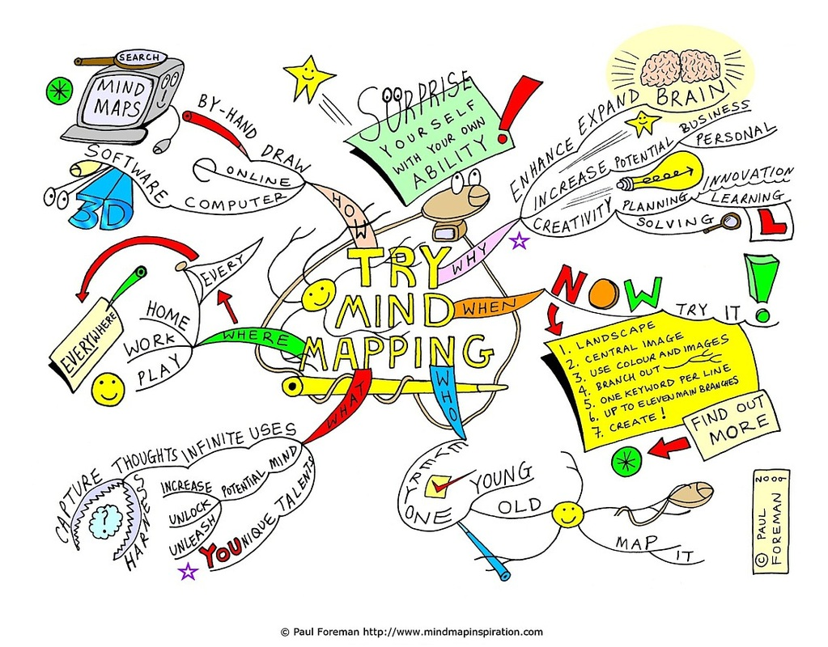
Mind Maps
Act II focus:
Nature
Love or hate
Light or dark imagery
Language or word play
Pattern 2: Categories
Take notes as we read in order to trace motifs/symbols.
4 examples per motif

Slide 13
Examples of motifs from Act I
Nature motif- stars, sky, birds, earth, etc.
“Earth-treading stars that make dark heaven light” (1.2.14).
“When well –appareled April on the heel/ Of limping Winter treads” (1.2.27).
Light or dark imagery- sight, blindness, light, dark
“Do I live dead that live to tell it now” (1.1.239). (dark imagery)
“Being but heavy, I will bear the light” (1.4.12). (light imagery)
Love or hate-
“Did my heart love till now? Forswear it, sight!” (1.5.57) (love)
“It fits when such a villain is a guest/ I’ll not endure him” (1.5.82).(hate)
Language or word play- double meanings, foreshadowing, etc.
“My grave is like to be my wedding bed” (1.5.151). – Juliet would die if he were married- She does!
“Of a despised life, closed in my breast/ By some vile forfeit of untimely death” (1.5.118-19). – Romeo predicts his own untimely death!

Slide 14
Romeo and Juliet
R&J Act II, scene i
Romeo | Alex S. | Phil
Benvolio | Miles | Rachel
Mercutio | Bennie | Andrick
R&J Act II, Scene ii
R&J Act II, scene iii
Romeo | Mathew | Skylar
Juliet | Autumn | Maya R
Nurse | Raina | Maya
Friar Laurence
Romeo

Slide 15
Romeo and Juliet- Act II
R&J Act II, scene i
Romeo
Benvolio
Mercutio
Nurse
Peter
R&J Act II, Scene v
R&J Act II, scene vi - confession of love and marriage.
Juliet
Nurse

Slide 16
Warm Up 5/5
If you did not get a chance to write this PEA paragraph, please do so now.
You will turn this in!
Write a PEA paragraph on whether or not you agree with the marriage between Romeo and
Juliet. Follow this format.
P: _______________ should/should not be married.
E: They should/ should not be married because _______________.
A: Because of ________________, this proves _______________________.
E: Another reason they should/should not be married is because ____________________.
A: Since ______________ this __________________________.
2. Already turned in the PEA paragraph from last class?
Which character can you relate to? Why?
Romeo- Lovesick- needs someone to make them whole- sensitive
Juliet- looking to defy your parents and set out on your own
Tybalt- angry with a distaste for those you dislike, but mindful of your family
Benvolio- always there for your friends, good listener, rarely share your problems
Mercutio- the jokester- you strive to make others happy because you’re so miserable
Nurse- You’re a good friend and a confidant; you’d do anything for a family member
Friar Laurence – Looking to solve problems at whatever cost
Lady & Lord Montague & Capulet – holding a grudge because it’s what you do.
Servants- Feeling like people walk all over you just because they can; still stick up for those people

