Slide 1
Agenda: Tuesday November 8, 2016
Warm up
Vocabulary 4 (1, 2, 3)
Identifying fragments
This I Believe
Blank Slate project due Th. 11/10
Random fact of the day:
347,000 tweets are sent every minute!

Slide 2
Warm Up 11/8
What makes your voice different from others?
What is a compound sentence? A complex sentence?

Slide 3
Vocabulary 4: Reaching the End
Root Words: Fin- end sat- enough term-end
1. confine (v) – to keep within certain limits; to imprison
It was hard to confine the toddler to one area of the house.
2. definitive (adj)- final; most accurate and complete
Her definitive answer was that I could not go bungee jumping.
3. determine (v) – to set limits, to define
The principal will have to determine the best way to handle the problem.

Slide 4
P.U.G.S.
Notes:
Fragment- an incomplete sentence/ thought
Subject- Who or what the sentence is about
Verb- What the subject is doing (can be helping verb)
Ex. Going to the store.
Who is going to the store?
Ex. Jane is.
What is Jane?
Directions: wkst. 2 #1-20
If a sentence is complete, write C.
If it is missing a subject, write S.
It it is missing a verb, write V.
If the item as a subject and a verb, but does not express a complete thought, write N.

Slide 5
Class Notes: Choose 3 statements you agree with and tell me why you agree with them.
Life is fair.
Words can hurt.
What goes around comes around.
Teachers are your friends.
How you act in a crisis shows who you really are.
Love conquers all.
An eye for an eye makes the whole world blind.
People learn from their mistakes.
You can’t depend on anyone else; you can only depend on yourself.
If you smile long enough, you become happy.
Miracles do happen.
There is one special person for everyone.
Money can’t buy happiness.
Killing is wrong.
Doing what’s right means obeying the law.

Slide 6
This I Believe Essays
Be Cool to the Pizza Dude
Misspelling the Word “Of”
Find a Good Frog
What do you think the author looks like?
Why do you think this?
4 x 4 chart

Slide 7
Exit Ticket
Split ½ sheet of paper with a neighbor.
Disclaimers:
Put your name on the back.
I will be reading these out loud.
Write 1-3 sentences describing getting up and getting ready for school.
Imagine that you’re talking to one of your friends (minus the profanity).

Slide 8
Brianna
Fabian
Janee’
Raina
Osiel
Skylar
Michael
Autumn
Mylissa
Sage
Topher
Steven
Alex
Gisselle
Matt
Jonessa
Destiny
Brock
Miles
Jake
Gabe
Alondra
Dawan
Tristen
Dre’
Phelps’ Desk
NOT SO SMARTBOARD
DOOR

Slide 9
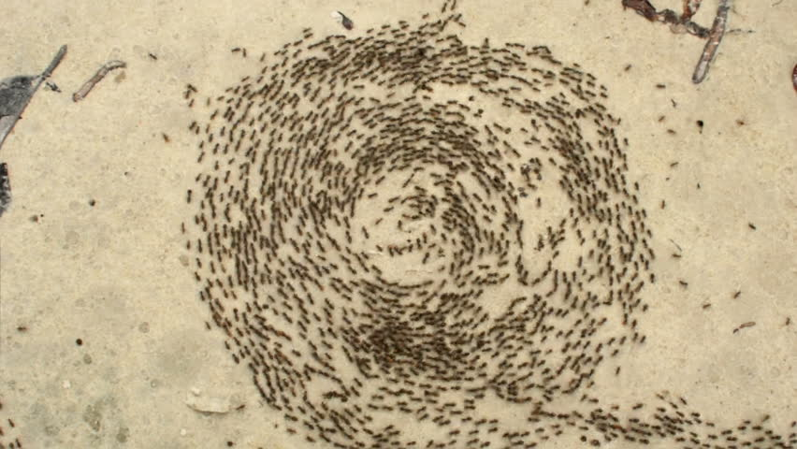
Agenda: Thursday November 10, 2016
Warm up
Vocabulary 4 (4, 5, 6)
Fixing fragments
This I Believe
Blank Slate project due today!
Random fact of the day:
Ants can accidentally misinterpret the chemical trails left by other ants and start walking in circles. If too many members of the colony join in, it can kill the whole colony in what is sometimes known as the 'Death Spiral.'

Slide 10
Warm Up 11/10
Why should you use compound/complex sentences in your writing?
What types of sentences and/ or punctuation indicate speaking quickly or directly?
What types of sentences or punctuation indicate speaking slowly, or telling a story ?

Slide 11
Vocabulary 4: Reaching the End
4. finale (n)- the last scene of a show or the last movement of a musical performance
For the finale the orchestra played a concerto by Mozart.
5. indeterminable (adj) – cannot be determined
The damage from the hurricane is indeterminable at this point.
6. infinite (adj) – without limits; endless
Looking up at the night sky, it seemed like there were an infinite number of stars.

Slide 12
P.U.G.S.
Notes from Tuesday:
Fragment- an incomplete sentence/ thought
Subject- Who or what the sentence is about
Verb- What the subject is doing (can be helping verb)
Directions: wkst. 4 #1-12
Using the provided fragment, create a sentence.

Slide 13
Writing: Voice
Word choice – slang, formal, made up words, etc.
Ex. Imma be right back. – slang.
Ex. I will return shortly. – formal/informal (depends on person)
Rhythm- long vs. short sentences; commas vs. periods or semi colons
Ex. When we are annoyed, frustrated, angry, and/or excited we speak in short sentence. “I’m fine.” “Leave me alone.” “Go away.” “Yes. I can go!”
Ex. When we are comfortable, concerned, , we speak in long run-on sentences.
“So I was walking in the hallway and I heard the boy in front me talking about Katie, but I couldn’t really hear what he was saying, so I kept getting closer until he realized that I was write behind him and he looked at me like I was crazy, so I said “hi” and tried to pretend like I wasn’t listening to his conversation, but he gave me a strange look and walked away.

Slide 14
Voice Exercise
Whose voice is whose?

Slide 15
This I Believe Essays
Be Cool to the Pizza Dude
Misspelling the Word “Of”
Find a Good Frog
# off 1-4
1: responsible for reading essay and pointing out where the belief is directly or indirectly stated.
2: responsible for reading essay and identifying specific evidence
3: responsible for reading essay and identifying voice- what do you think the author looks like, why? Give me specific word choices, sentences, etc.
4: responsible for reading essay and identifying what the author learned, or why he/she believes what he/she believes.

Slide 16
Belief/ Quote
Evidence/ Anecdote
I believe in looking out for each other.
Park in the last parking space.
Put back items in the right places.
Clean up after myself
Be mindful of surroundings- let people know if they’re going to walk into something.
Analysis- Why do you believe this?
Voice- how you speak (no profanity)
Metaphor-
If we look out for each other, we are more often to see the good and positive in each other.
Society wouldn’t be so divided.
Growing up- the neighborhood parents looked out for all of the kids in the neighborhood: we all got along.
Schools did the same thing.

Slide 17
TIB draft
Begin writing based on your quadrant
Remember, this is a personal essay.
Write based on your personal experiences.
Will need to be at least 500 words.

Slide 18
Deon
Ivy
Rachel
Blake
Tristan
Tyler
Kaleb
Christina
Spike
Ethan
Maddie
Andrick
Ana
Ricardo
Ben
Brandon
Espy
Michael
Jaylyn
Carlos
Anthony
Alex
Ayden
Seriah
Elexis
Oswaldo
Chris
Phelps’ Desk
NOT SO SMARTBOARD
DOOR

Slide 19
Matt
Aimee
Alejandro
Bennie
Keelyn
Jacob
Maya R.
Gracie
Cesar
Maddy
Cielo
Adam
Andrew
Nevaeh
Reese
Brad
Alex
Caleb
Dylan
Phil
Nyasia
Maya K.
Phelps’ Desk
NOT SO SMARTBOARD
DOOR

