Slide 1
Agenda: Monday October 31, 2016 Happy Halloween!
Warm up
Vocabulary 3 (7, 8) TEST FRIDAY!
Mock Trial preparation
Mock Trial
Update PEA paragraphs
Missing work due Wednesday Nov. 2
Random fact of the day:
Halloween is one of the oldest celebrations in the world, dating back over 2000 years to the time of the Celts who lived in Britain.

Slide 2
Missing work: 1st period End of end 6 weeks: Nov. 4- Next Friday! Make up work due by Wednesday Nov. 2nd
Short story assessment:
Vocabulary 2 Participation: cannot be made up
Vocabulary 2 Grid: Tristan, Espy, Anthony, Ricardo
Vocabulary 2 Test: Espy, Ricardo
Mythology Project: Tristan, Espy, Seriah, Carlos, Anthony, Ricardo, Brandon

Slide 3
Missing work: 2nd period End of end 6 weeks: Nov. 4- Next Friday! Make up work due by Wednesday Nov. 2nd
Short story assessment:
Vocabulary 2 Participation: cannot be made up
Vocabulary 2 Grid: Nyasia, Maya R., Cesar
Vocabulary 2 Test:
Mythology Project: Gracie, Maddy, Nevaeh,

Slide 4
Missing work: 4th period End of end 6 weeks: Nov. 4- Next Friday! Make up work due by Wednesday Nov. 2nd
Short story assessment: Michael
Vocabulary 2 Participation: cannot be made up
Vocabulary 2 Grid: Jake, Raina, Autumn, Michael, Mylissa, Janee’, Steven
Vocabulary 2 Test: Autumn, Michael, Mylissa
Mythology Project: Raina, Michael, Destiny

Slide 5
Warm Up 10/31
What do you know about trials?
Which side hero or villain, do you think will win the mock trial today?

Slide 6
Vocabulary 3: Able and Capable
7. laughable (adj) – causing laughter and amusement
Mom’s first attempt to roller blade was laughable.
8. amicable (adj) – spirit of friendliness
Although the students did not get along outside of school, they were still amicable in class.

Slide 7
Mock Trial
Heroes vs. Villains
3 attorneys on each side (opening, middle closing)
3 character witnesses on each side
5 members of the jury
5-7 members in the audience
1 judge
Opening attorney will have 5 minutes to present
Middle attorney and character witnesses will have approximately 15 minutes to speak (collectively)
Closing attorney will have 5 minutes to wrap it up
Jury will deliberate for 5 minutes
Judge will read the verdict
Trial should last around 30-35 minutes

Slide 8
Final Assessment: PEA paragraph
Do you think Odysseus is a hero or a villain? Why?
Use evidence from the text to support your answer.
Include 3 pieces of textual evidence.
Example:
Odysseus is a hero because he goes through the Hero’s Journey. After the Trojan War, Odysseus has another “call to adventure”. This adventure is his journey home. ¹He meets with Calypso, a Goddess, and Circe, an enchanted witch, who detain him for several years. In order to overcome these trials, he has to outsmart them. ²Odysseus has allies who help him throughout his journey, Athena and Hermes. Without the help of these two, he would be lost forever. ³Before he returns home, he literally goes to Hell or Hades because he needs to hear a prophecy from Tiresias. While Odysseus follows the instructions provided by Tiresias, his men fail to heed his words and they all perish. Odysseus, however, completes the hero’s journey and returns home.

Slide 9
Reflection
Split a half a sheet of paper with someone:
What did you like/dislike about the trial?
What would you change?
Would you rather do something like this for an assessment or would you rather have a test?

Slide 10
Agenda: Wednesday November 2, 2016
Warm up
Vocabulary 3 (9, 10) TEST FRIDAY!
Update PEA paragraphs
Blank Slate projects
Missing work due today!
Random fact of the day:
A healthy (non-colorblind) human eye can distinguish between 500 shades of gray.

Slide 11
Missing work: 1st period End of end 6 weeks: Nov. 4- Next Friday! Make up work due by Wednesday Nov. 2nd
Short story assessment:
Vocabulary 2 Participation: cannot be made up
Vocabulary 2 Grid: Tristan, Espy, Anthony, Ricardo
Vocabulary 2 Test: Espy, Ricardo
Mythology Project: Tristan, Espy, Seriah, Carlos, Anthony, Ricardo, Brandon

Slide 12
Missing work: 2nd period End of end 6 weeks: Nov. 4- Next Friday! Make up work due by Wednesday Nov. 2nd
Short story assessment:
Vocabulary 2 Participation: cannot be made up
Vocabulary 2 Grid: Cesar
Vocabulary 2 Test:
Mythology Project: Maddy, Nevaeh,

Slide 13
Missing work: 4th period End of end 6 weeks: Nov. 4- Next Friday! Make up work due by Wednesday Nov. 2nd
Short story assessment: Michael
Vocabulary 2 Participation: cannot be made up
Vocabulary 2 Grid: Jake, Raina, Autumn, Michael, Mylissa, Janee’, Steven
Vocabulary 2 Test: Autumn, Michael, Mylissa
Mythology Project: Raina, Michael, Destiny

Slide 14
Warm Up 11/2
What defines you?
Why are you the person you are today? (good, bad, happy, sad, mad, anxious, overachieving, apathetic, etc.)

Slide 15
Vocabulary 3: Able and Capable Test Friday!
9. tenable (adj) – able to be held, maintained, or defended
She gave a tenable argument for changing the recess schedule, but the principal rejected it.
10. volatile (adj) – changeable; easy to explode
She had a volatile temper, often flying off the handle for no apparent reason.

Slide 16
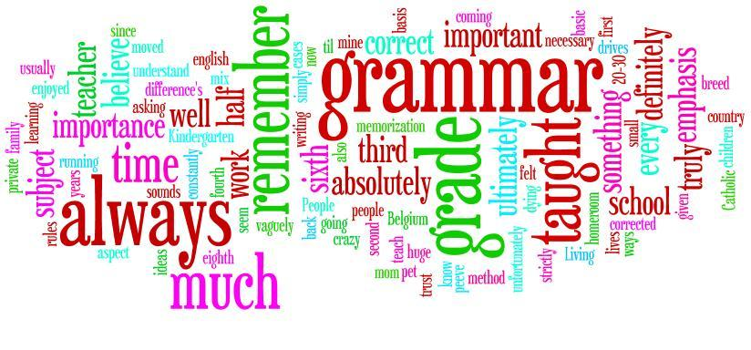
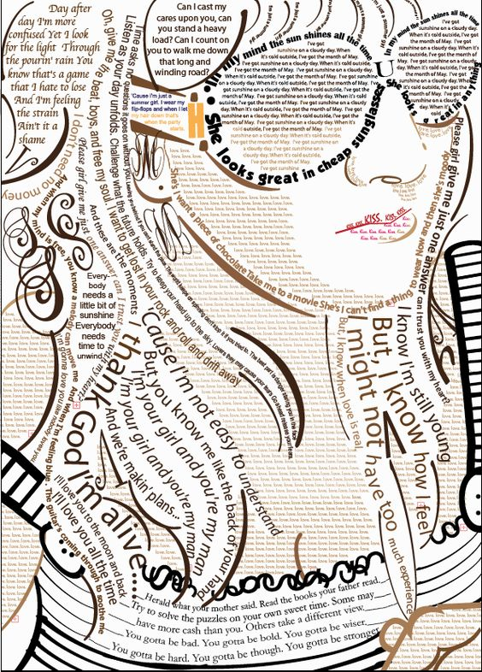
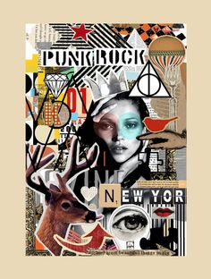
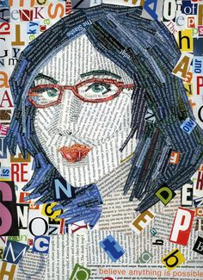
Blank Slate
Find the 10 values/experiences, etc. that make you who you are (from when I was absent)
Think of who you are as a person.
Capture that in a picture and/or a word.
Wordles = 25-30 words/ 3-5 images
Tagul.com

Slide 17
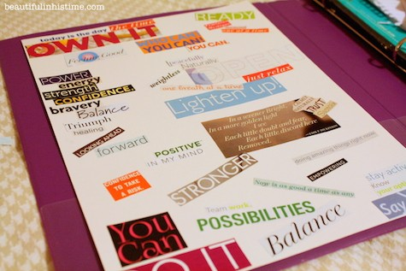
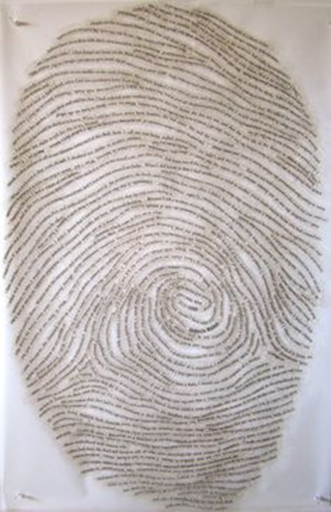
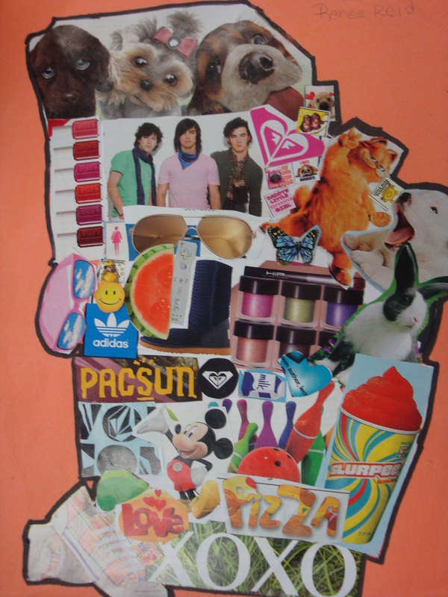
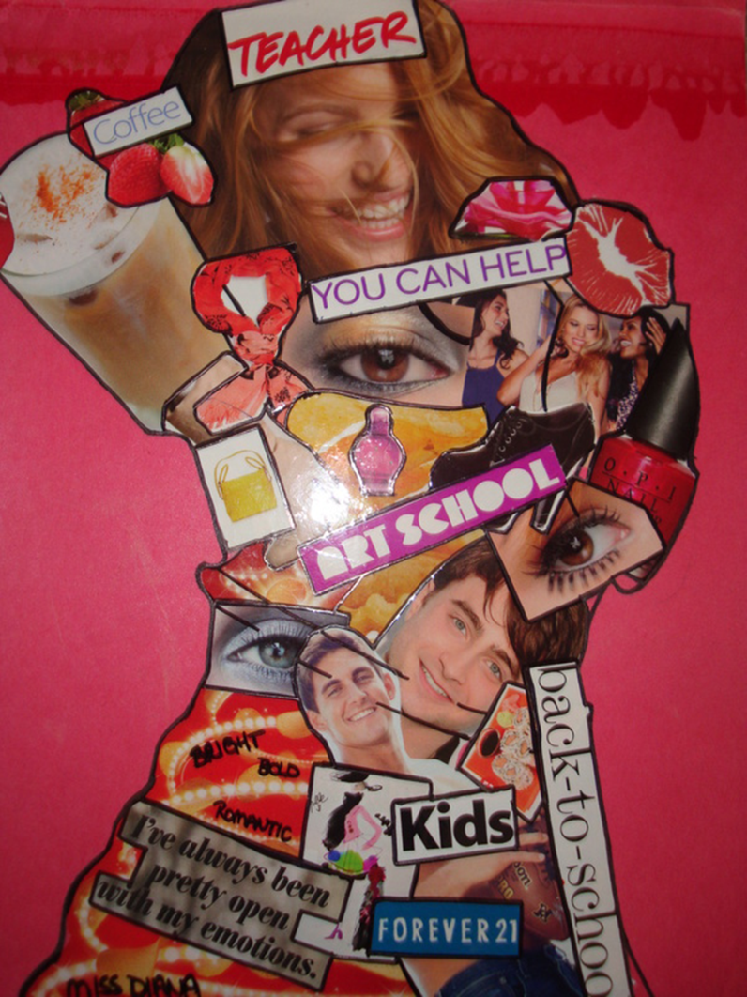
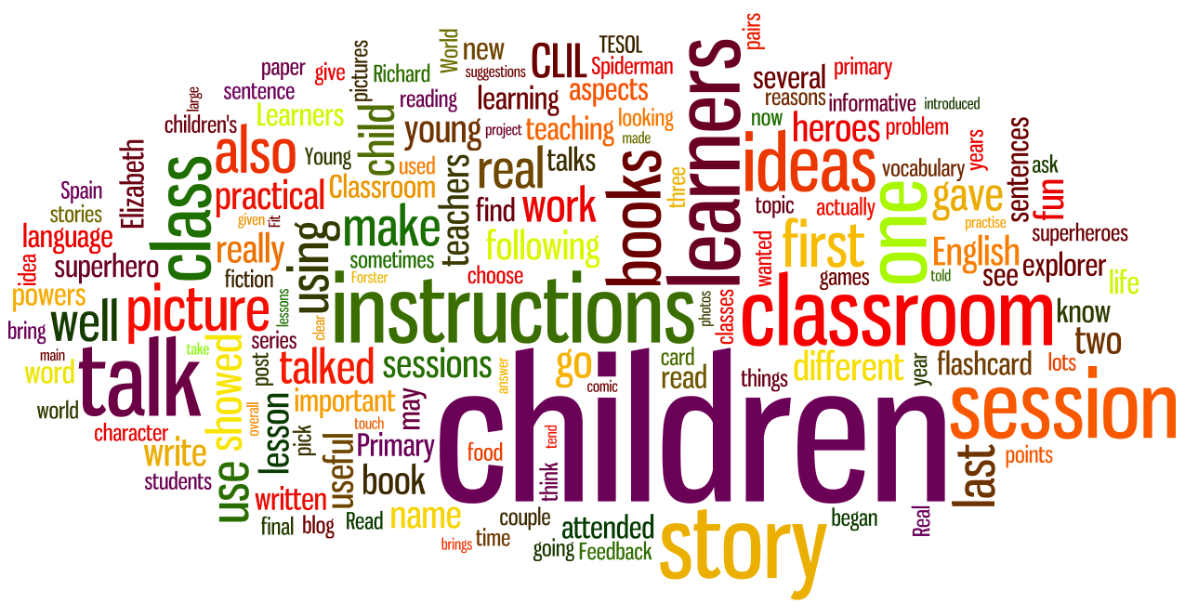

Slide 18
Agenda: Friday November 3, 2016
Warm up
Vocabulary 3 Test today!
Blank Slate projects
This I Believe
Random fact of the day:
The Neanderthal's brain was bigger than yours is.

Slide 19
Warm Up 11/3
1. Create the settings and/or scenarios for the songs you hear. What are the characters doing? Where are they? What do they look like?
A: Scenario 1
B: Scenario 2
C: Scenario 3

Slide 20
Vocabulary 3 TEST
TEST!
Turn in your squares
Finished? Work on your blank slate project or sit quietly.

Slide 21
Class Notes: Choose 3 statements you agree with and tell me why you agree with them.
Life is fair.
Words can hurt.
What goes around comes around.
Teachers are your friends.
How you act in a crisis shows who you really are.
Love conquers all.
An eye for an eye makes the whole world blind.
People learn from their mistakes.
You can’t depend on anyone else; you can only depend on yourself.
If you smile long enough, you become happy.
Miracles do happen.
There is one special person for everyone.
Money can’t buy happiness.
Killing is wrong.
Doing what’s right means obeying the law.

Slide 22
This I Believe Essays
Be Cool to the Pizza Dude
Misspelling the Word “Of”
Find a Good Frog
What do you think the author looks like?
Why do you think this?

Slide 23
Writing: Voice
Voice
Word choice
Rhythm
Patterns

Slide 24
Exit Ticket
Disclaimers:
Do not put your name on this.
I will be reading these out loud.
Write 1-3 sentences describing getting up and getting ready for school.
Imagine that you’re talking to one of your friends (minus the profanity).

