Slide 1
Agenda: Wednesday October 19, 2016
Vocabulary 3 (1, 2)
Reading- The Odyssey
Writing – Greek values
Random fact of the day:
In your lifetime you will produce enough saliva to fill 2 swimming pools.

Slide 2
Vocabulary 3: Able and Capable
Suffixes: -able, -ible- can do
-il, -ile – capable of being, like
1. civil (adj) – polite and respectful; acting with courtesy and civility
Though his customer was angry, the sales clerk handled his complaint in a civil manner.
2. docile (adj) – easy to manage; gentle; easy to teach or discipline
Jorge was a calm, docile child, unlike his twin sister, who was untruly and rebellious.

Slide 3
Pop Quiz
You may use your notes from Monday:
What natural phenomenon is controlled by Aeolus?
Who helps Odysseus outwit Circe?
Why must Odysseus visit the underworld?
Why is Odysseus’ mother in the underworld?
What lesson does Odysseus learn in his dealing with Poseidon?

Slide 4
Writing: The Odyssey/ Complex Sentences
Switch paragraphs with someone at your table.
Underline or highlight evidence – specific examples
If no evidence- write NO EVIDENCE
Circle or star complex sentences

Slide 5
Writing: The Odyssey/ Complex Sentences
Which Greek value do you think is the most important? Why?
Belief/Faith -Hospitality P = Point
Intelligence -Loyalty E= Evidence
Glory - Bravery A= Analysis
Use specific examples:
Highlight complex sentences
Highlight compound sentences
IC, FANBOYS, IC I bought cookies, but I forgot milk.
Highlight simple sentences
I bought cookies.

Slide 6
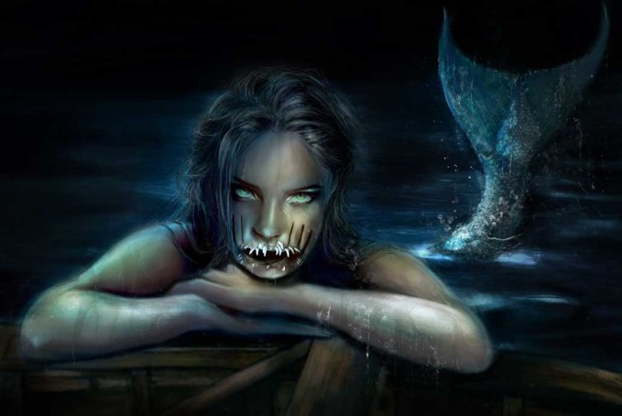
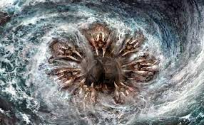
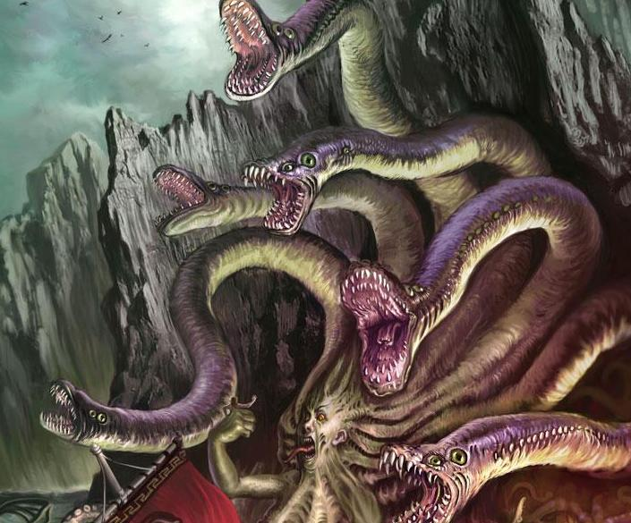
Reading/ Literature: The Odyssey Active Reading
Book 12: The Sirens; Scylla and Charybdis
1-2 sentence summary, key conflict, key characters,, human values/behaviors, gods/goddesses behaviors, something interesting
Odysseus clearly faces monsters, but what real life human experiences could these monsters represent?

Slide 7
Agenda: Friday October 21, 2016
Warm up
Vocabulary 3 (3, 4)
MAP goals
The Odyssey- viewing guide
Random fact of the day:
Children grow faster in the springtime.

Slide 8
Vocabulary 3: Able and Capable
Suffixes: -able, -ible- can do
-il, -ile – capable of being, like
3. edible (adj) – able to be eaten
Artichokes are edible thistles.
4. futile (adj) – useless; ineffective; incapable of producing the desired effect
His efforts to remove the stump were futile; it would not budge.

Slide 9
Map Goal reporting
Lhstiger.weebly.com
-Under Students (left side of screen)
-Submit Reading Goal
Must be specific. What do you want to achieve and how will you do it?
Ex. I will increase my informational reading skills by finding non-fiction articles that I am interested in (education, social issues).

Slide 10
Writing: The Odyssey/ Complex Sentences
Switch paragraphs with someone at your table.
Underline or highlight evidence – specific examples
If no evidence- write NO EVIDENCE
Circle or star complex sentences

Slide 11
Writing: The Odyssey/ Complex Sentences
Which Greek value do you think is the most important? Why?
Belief/Faith -Hospitality P = Point
Intelligence -Loyalty E= Evidence
Glory - Bravery A= Analysis
Use specific examples:
Highlight complex sentences
Highlight compound sentences
IC, FANBOYS, IC I bought cookies, but I forgot milk.
Highlight simple sentences
I bought cookies.

Slide 12
Reading/ Literature: The Odyssey Active Reading
Book 12: The Sirens; Scylla and Charybdis
1-2 sentence summary, key conflict, key characters,, human values/behaviors, gods/goddesses behaviors, something interesting
Odysseus clearly faces monsters, but what real life human experiences could these monsters represent?

