Slide 1
Agenda: Tuesday January 10, 2017
Warm Up
TKAM- background
TKAM- anticipation guide discussion
TKAM- Ch. 1&2
Remember, NO cell phones; please put them in the basket!
HW: Chapters 3 & 4
Audio book on lhsphelps.weebly.com
Random fact of the day:
Antarctica is the only continent with no spiders.

Slide 2
Warm Up: 1/10 (5-6 minutes)
Identify the following parts of speech based on underlined words/phrases:
Noun, verb, adverb, adjective, preposition, conjunction, interjection
1. The Museum of Modern Art is located in New York City.
2. The museum houses collections of art from 1880 to the present.
3. The exhibits include paintings, sculptures, photographs, and much more.
4. Built in 1939, the original building showcases the International Style of architecture.
5. In the 1950s and 1960s, the museum was expanded.
6. Yikes! I wouldn’t want to be the person flying those kites!
7. Easy to build, delta kites fly readily in a light wind.

Slide 3
TKAM: Anticipation Guide
1. Choose 2-3 statements you feel strongly about (True or False) and discuss with a partner.
Put a star next to those 2-3 statements
2. Partners- discuss your statements and why you feel so strongly about them. (2-3 minutes)
3. Whole class discussion

Slide 4
TKAM: Historical Context
Published in 1960
Civil Rights movement - Began in 1950’s
Brown vs. Board desegregation - 1954
Resistance to school integration
Civil Rights Act passed in 1965
Setting: Takes place in the 1930’s in a small southern town
Correspondence between race relations when examining the time of publication and time of setting
The South was steeped in agricultural traditions, and was hit hard by the Great Depression
Small farmers could not earn enough to cover living expenses - sharecropping
Desperate economic conditions created more racism.
Finding work was already difficult for many Black Americans prior to the depression - that difficulty only worsened
Government assistance was offered but prevented by violent racist groups like the Ku Klux Klan
Lynching still common in the South, especially when blacks tried to take jobs

Slide 5
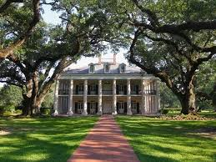
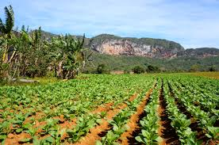
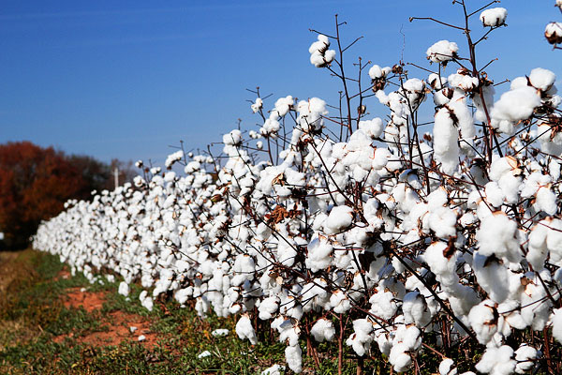

Slide 6
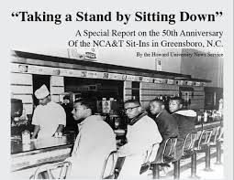
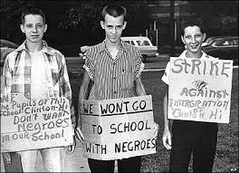
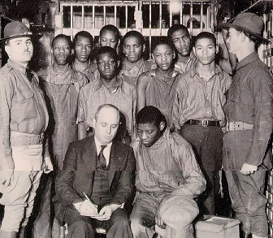
TKAM: Historical Context

Slide 7
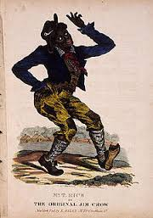
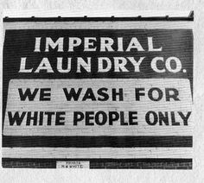
TKAM: Jim Crow Laws
Between 1877 and mid-1960s - rigid set of anti-black laws which made racism a way of life
Relegated Black Americans to second class citizens
“Jim Crow” - white actor played a caricature of a clumsy, dim-witted black slave - derogatory terms for Black Americans
Jim Crow Laws
Video ^

Slide 8
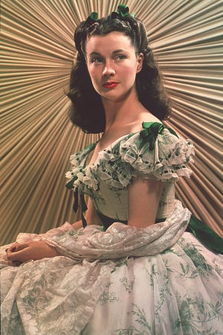
Southern White Womanhood
Plantation life ideal:
White Woman: Moral compass for men
Cares for family: center of morality
Exemplar of purity and innocence
Well bred; always put together; social life surrounds them- “the belle of the ball”
The upper-class male understood the high status of white womanhood in southern society and felt compelled to protect it from any threat.
A threat to the woman was a threat to the gentleman’s honor

Slide 9
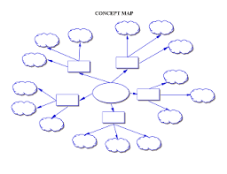
TKAM: Intro Activity
Create a concept web for one of the words:
“courage”, “innocence”, or “status”.
Draw lines extending from the word,
Then on each line, list qualities that you associate with someone who shows courage.
Connect situations which require courage.
Also connect real-life situations you know of in which people have acted courageously.

Slide 10
TKAM: Chapter 1 & 2
View Chapter 1
Focus on the setting, the characters, and the POV
Read chapter 2:
Pull out quotes that stand out or resonate with you
HW: Finish Chapter 2 → Read chapters 3 & 4
Create a character list in your notes – add small descriptions as you read

Slide 11
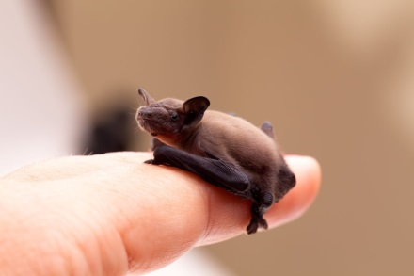
Agenda: Thursday January 11, 2017
Warm Up- prepositions
TKAM- Ch. 1-4 quiz and discussion
Dialectical Journals
Remember, NO cell phones; please put them in the basket!
HW: Chapter 5
Audio book on lhsphelps.weebly.com
Random fact of the day:
The world’s smallest mammal is the bumblebee bat of Thailand, weighing less than a penny.

Slide 12
Warm Up: 1/12 (5-6 minutes)
Prepositions – shows the relationship between two nouns
Ex. The dog slept near the bed. (Near tells you where the dog slept.)
Identify the prepositional phrase:
The girl jumped on the bench.
Cody ran into the house.
Ryan put away the stack of boxes.
The bird was on top of the tree.
Mrs. Phelps walks around her desk.

Slide 13
TKAM: Quiz

Slide 14
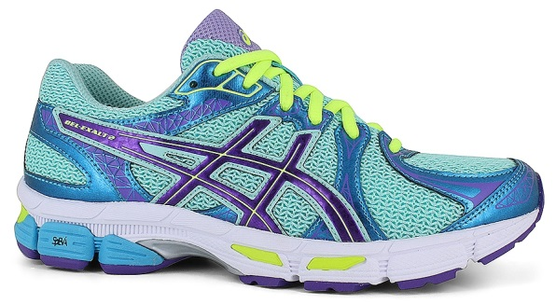
TKAM: Descriptive writing based on images
There are 10 pairs of shoes around the room.
Choose 3 different pairs and write as if you were the owner of those shoes.
What do you look like?
What do you sound like?
Do you work? Go to school?
How old are you?
Where do you live?
What is the weather/climate like?
What does a typical day look like in your life?
Your answers should be based on the shoes, not your own
personal story.

Slide 15
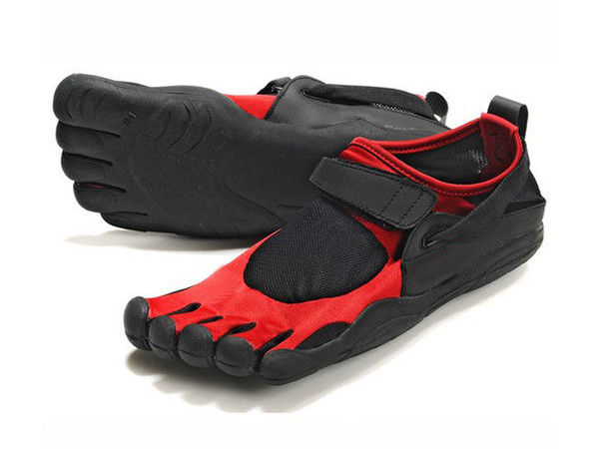
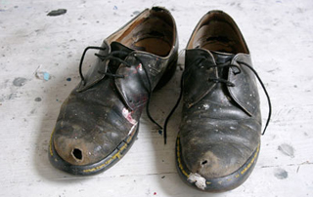
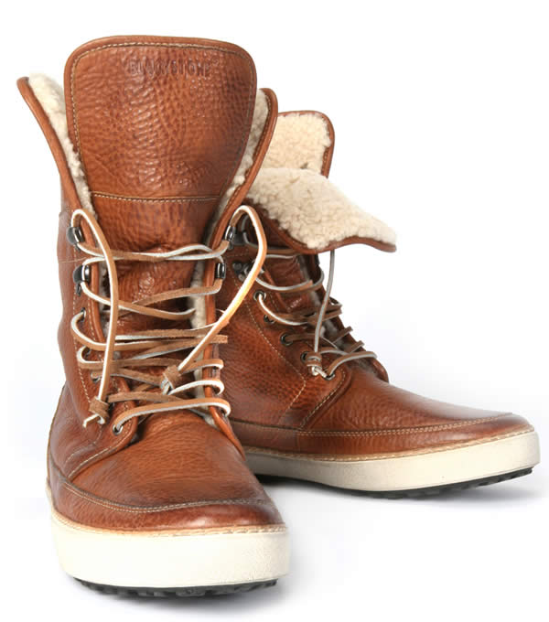
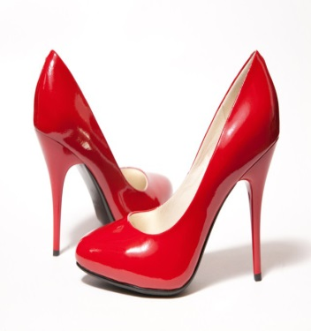
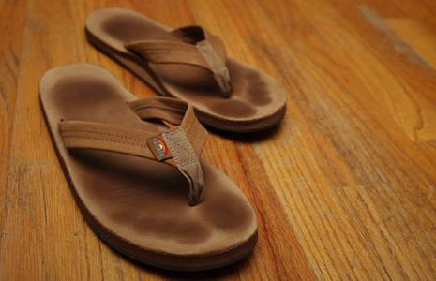
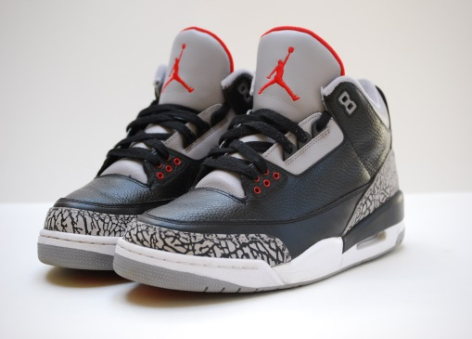
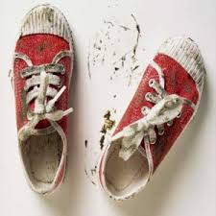
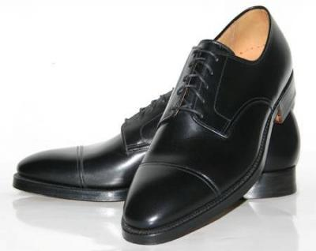
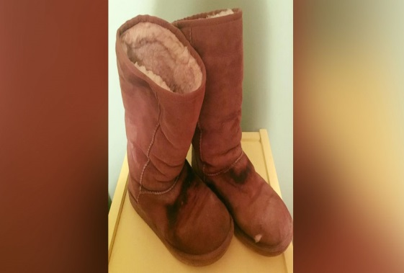
"First of all," he said, "if you can learn a simple trick, Scout, you'll get along a lot better with all kinds of folks. You never really understand a person until you consider things from his point of view […] until you climb into his skin and walk around in it" (Lee, pg. 33).

Slide 16
TKAM: Discussion- Chapters 2-4
Where do our judgements come from?
Why are children (ages 4-12) more or less likely to confront judgements?
Add quotes to your DJ journal.
You will need 2 quotes per chapter.

Slide 17
Read like a reader; read like a writer

Slide 18
TKAM: Dialectical Journals
Essential Questions How do writers use literary elements to develop theme?
How do readers identify and use literary elements to evaluate theme?
Prompts:
Easier | Medium | Harder
Content: Describe how racism affects the events in the novel To Kill a Mockingbird by analyzing at least 3 significant moments, dealing with race, from the novel. Craft: How is characterization used to establish the theme? Which characters exemplify this theme? | Content: A recurring symbol throughout the novel To Kill a Mockingbird is the story Atticus tellsl his children, “...it is a sin to kill a mockingbird.” Explain this metaphor and analyze the ways in which Atticus Finch, Tom Robinson, and Boo Radley are all metaphorically portrayed as mockingbirds. Craft: How does Lee’s use of point of view & perspective affect the reader’s mood and understanding of the text. | Content:Describe the ways in which economic class (how much money people have) affect the events in the novel To Kill a Mockingbird, by analyzing at least 3 significant moments, dealing with class, from the novel. Craft: How does Lee use imagery to develop the tone? How does that tone help to establish the theme?

Slide 19
TKAM: DJ Journal Example
Quote/Passage | Thematic concept: | Literary Element: | Commentary: Explain the quote
Craft: How is characterization used to establish the theme? Which characters exemplify this theme? “His absence of shoes told us how got them… If Walter had owned any shoes he would have discarded them until mid-winter. He did have on a clean shirt and neatly mended overalls” (Lee, pg. 21). | Pride | Characterization | Because Walter didn’t have any shoes, we can assumed that he is poor and doesn’t have much. Shoes must be worth something if students wore them the first day. It appears many students go barefoot. Although Walter may not have shoes, his appearance is described as clean which leads us to believe that he and his family are prideful people. Scout’s matter of fact description of Walter lead the reader to believe that she has many no judgements about his appearance or situation.
MLA format: When you take a quote or a passage from a book, you MUST cite it.
Parenthetical citations: (Author, pg. #).

Slide 20
TKAM: DJ Journal Example
Pull another quote from Chapter 2. It can relate to any literary term or thematic concept.
Make sure it addresses one of the prompts:
characterization, point of view, symbol, racism, social status, imagery, tone.
Quote/Passage | Thematic concept: | Literary Element: | Commentary: Explain the quote

